Slide 1
Globalizing the Liberal Arts
Soka University
June 3 – 5, 2018
Toward inclusive learning cultures in STEM:
Integrating embodied understanding of diversity and identity through self-authored narratives and theatre
Kathy Takayama
Senior Science Education Fellow
Howard Hughes Medical Institute

Slide 2
Globalization in STEM learning:
inclusivity
excellence through diversity
intersectionality and identity

Slide 3
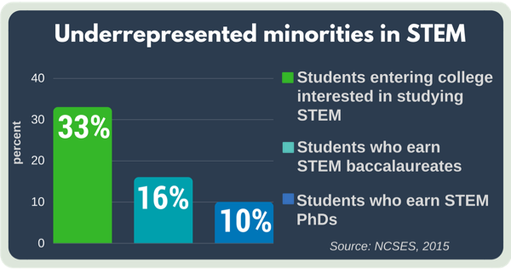
US data: Persistence of undergrad STEM aspirants
from HHMI: A New Strategy to Build Capacity for Creativity, D. Asai. Available: https://www.hhmi.org/content/new-strategy-build-capacity-creativity-science-education
Notes:
A third of US first-year undergrads intending to study STEM are URMs.
But only one sixth of STEM baccalaureate degree recipients and one-tenth of STEM PhDs are URMs.

Slide 4
A. Finley & T. McNair (2013) Assessing underserved students’ engagement in high-impact practices. Washington, DC: American Association of Colleges and Universities
How do students articulate the effects and meaning of their learning?

Slide 5
The learning experiences that most stood out to students:
Connections between how their learning environment facilitated a sense of self-worth and empowerment.
Importance of individual identity as central to their meaning-making
Students’ personal development
Intentionally making the diversity of students’ experiences part of the discourse and applicable to course material.

Slide 6
Patti McGill Peterson’s keynote:
Knowledge
Skills
Attitudes [Dispositions]

Slide 7
Other themes from yesterday:
enduring questions of humanity; social context (Penprase)
integration of ethical understandings into engineering education (Helfand)
rooted globalism (Pickus) – being knowledgeable about each other’s histories...
defamiliarization (Dwyer) – seeing your own world through the vision of someone else
scaffolded connections between ”self” and humanity as a whole – the concentric circles of experience (Gonzalez)

Slide 8
being present
generosity
risk-taking
celebrating failure

Slide 9
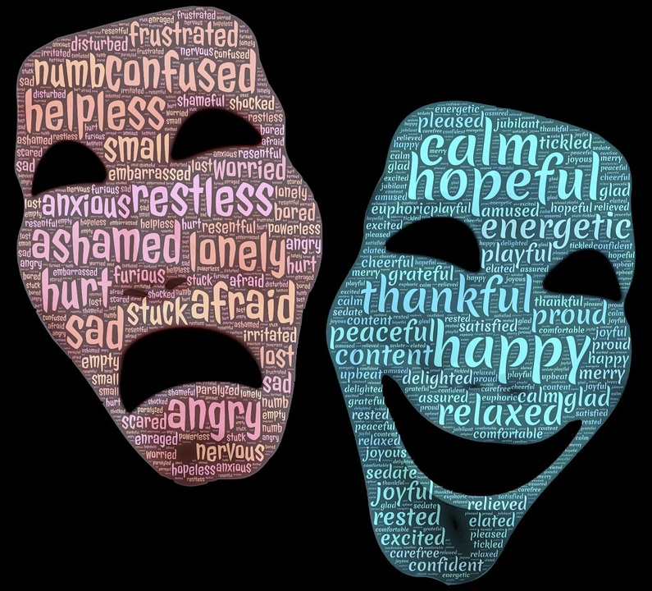

Slide 10
Faculty
Who are you? What inspires you?
What assumptions might others have about you?
What have your own experiences been during your educational/scientific training?
Inclusivity; Microaggressions
STEM Identity

Slide 11
Students
Who are the students in your classroom? What assumptions do you/have you had about them? Or, what assumptions do they/might they have about you?
What does it mean to “belong” (and not belong) in STEM?
Stereotype threat
STEM Identity

Slide 12
Theatre + STEM inclusive pedagogy:
an integrated framework
How do we create a welcoming space:
- physical presence, gestures, generosity, reciprocity – “Yes, and...”
Be present, intentional in the language that we use.
STUDIO

Slide 13
Theatre + STEM inclusive pedagogy:
an integrated framework
Celebrating failure – creating a space for the narrative of failure.
Narratives and pathways: telling our stories of STEM – the importance of failure in this narrative.
STUDIO

Slide 14
Ever tried. Ever failed. No matter.
Try again. Fail again. Fail better.
- Samuel Beckett, Worstward Ho

Slide 15
Inclusion and Course Context
STEM includes our identities, stories, meaning-making, embodied understanding
Identities
Microaggressions
Stereotype
threat
Narratives;
Failure as a process
Generosity; Physical space; Exploration of boundaries
Inclusive STEM pedagogy for global mindset

Slide 16
STEM as a space for students to contribute their identities; to belong; to connect across the disciplines and beyond the curriculum; to author their narratives as global citizens

Slide 17
Contact
takayamak@hhmi.org

