Slide 2
Overview of the Curriculum

Slide 3
Sample Student Pathway at Yale-NUS College
YEAR | SEMESTER ONE | SEMESTER TWO
01 | Literature & Humanities 1 Philosophy & Political Thought 1 Quantitative Reasoning Comparative Social Inquiry | Literature & Humanities 2 Philosophy & Political Thought 2 Scientific Inquiry 1 Elective
02 | Modern Social Thought Scientific Inquiry 2 Two Electives | Four Electives
03 | Historical Immersion* Two Majors Elective | Three Majors One Elective
04 | Capstone Project in Major Two Majors Elective | Capstone Project in Major Two Majors Elective
*can be taken any time in year-3 or year-4

Slide 4
Philosophy and Political Thought 1&2
 | Semester 1 | Semester 2
 | Philosophy & Political Thought 1 | Philosophy & Political Thought 2
Week 1 | Mozi | Śāntideva, The Bodhicaryāvatāra
Week 2 | Mengzi | Ibn Tufayl, Hayy Ibn Yaqzān
Week 3 | Xunzi | Zhu Xi, Categorized Conversations
Week 4 | Zhuangzi | Annambhatta, Primer on Reasoning
Week 5 | Plato, Meno | Lucrezia Marinella, Nobility of Women, Vices of Men
Week 6 | Plato, Crito | René Descartes, Meditations
Recess week
Week 7 | Week 7 field experiential learning | Thomas Hobbes, Leviathan
Week 8 | Aristotle, Ethics | Huang Zongxi, Waiting for the Dawn
Week 9 | Aristotle, Politics | J. S. Mill, On Liberty
Week 10 | Hellenistic Philosophy | Friedrich Nietzsche, Genealogy of Morals
Week 11 | Bhagavad Gītā | 20th-century Chinese political texts
Week 12 | Śaṅkara and Rāmānuja on the Gītā | M. K. Gandhi, Hind Swaraj
Week 13 | Milinda's Questions | Hannah Arendt, “Thinking and Moral Considerations”
Week 14 | Indian philosophers debate the Self

Slide 5
Literature and Humanities 1 & 2
 | Semester 1 | Semester 2
 | Literature & Humanities 1 | Literature & Humanities 2
Week 1 | The Ramayana in historical context | Shakespeare, The Tempest
Week 2 | The Ramayana in Southeast Asia | Honoré de Balzac, Père Goriot
Week 3 | The Ramayana in South Asia | Père Goriot
Week 4 | Homer, The Odyssey | Baudelaire, selected poems
Week 5 | Odyssey | Lu Xun, short stories
Week 6 | Odyssey | Lu Xun, short stories
Recess week
Week 7 | Week 7 field experiential learning | Virginia Woolf, Mrs. Dalloway
Week 8 | Herodotus, The Histories | Mrs. Dalloway
Week 9 | Histories | 20th century avant-garde manifestos
Week 10 | Sima Qian, Ren An Letter, Gaozu Annals | Eileen Chang, Love in a Fallen City
Week 11 | Sima Qian, Annals of Qin, Da Yuan | Love in a Fallen City
Week 12 | The 1001 Nights | Tayeb Salih, Season of Migration to the North
Week 13 | Bocaccio, The Decameron | Sonny Liew, The Art of Charlie Chan Hock Chye
Week 14 | Decameron

Slide 6
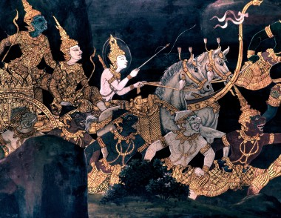
Southeast Asian culture

Slide 7
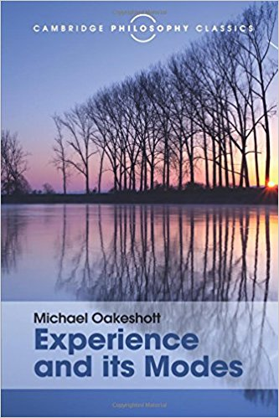

Slide 9
