Slide 1
Integrating Off-Campus Study: Colby College’s Faculty Mentoring (Pilot) Program
Globalizing the Liberal Arts - Capturing the Global Experience
Soka University, CA, 2018
Arne Koch, Dean of Global Engagement akoch@colby.edu

Slide 2
Overview
Description of Off-Campus Study and its new Faculty Mentor Program at Colby
Identification of challenges and suggestions for ways in which an institutional commitment to integrating students’ study abroad experiences may be applicable elsewhere.

Slide 3
By the numbers: Off-Campus Study at Colby
2000+ students, 58 majors, 35 minors
40-50% study abroad semester or full-year (49% this yr)
70% learn abroad (incl. research and internships)
200+ OCS programs in 60+ countries
Portable aid for OCS experiences

Slide 4
The Task
Global Task Force, May 2016
How to promote integration of study abroad into fabric of institution to promote faculty exposure to students’ study-abroad experience and at same time enhance departmental oversight of students’ off-campus experiences, requiring them to articulate academic and personal goals?
September 2017
Global Engagement Faculty Advisory Committee and OCS Faculty Advisory Committee propose OCS Faculty Mentor Program

Slide 5
Piloting (a.k.a. Building a Plane in Mid-Flight)
Four-month process of collaborating with different campus partners
OCS and Dean of Global Engagement together
with Provost, Sophomore/Junior Advising Deans, Writing Program, Academic ITS, and Counseling Services

Slide 6
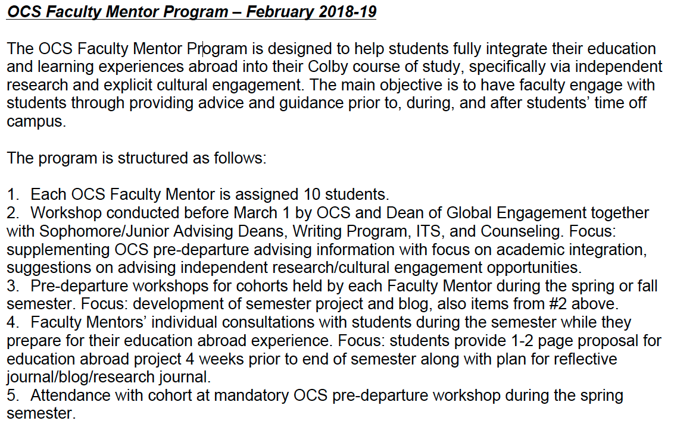
The Program at a Glance

Slide 7
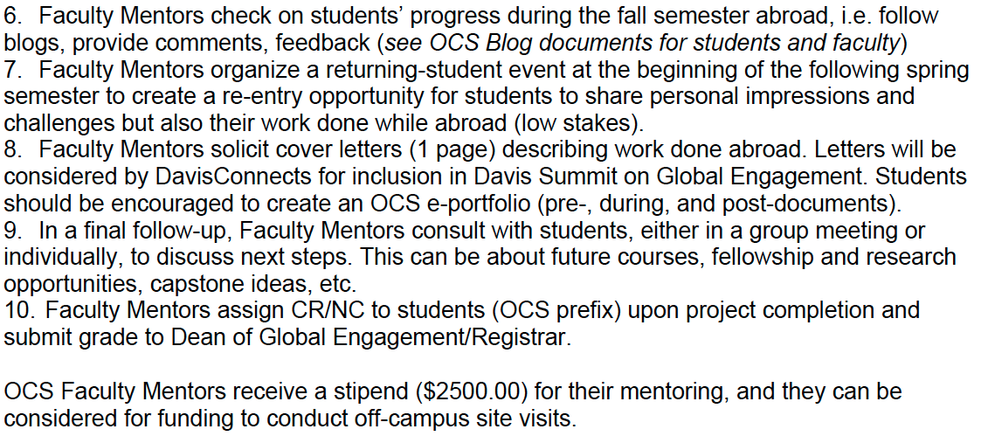

Slide 9
Logistics: Challenges and Success
Learn to Tell the Story → so students can tell the story
Integration of Davis Global Summit (UG Research)
Concurrent Assessment and Future Planning
Faculty and Student Buy-In → 6 faculty/57 students for pilot
Matching faculty and students
Collaboration → Blog Writing 101 and Website
Academic Affairs: Challenges to OCS course credit

Slide 10
