Slide 1
Science Diplomacy in the Asia-Pacific: International Environmental Chemistry
Katie Purvis-Roberts
Claremont McKenna, Pitzer, & Scripps Colleges

Slide 2
“Given the relevance of international exposures to the current trend in globalization and the limited exposure to international peers majoring in chemistry, chemistry degree programs should be structured to facilitate the development of international competencies in their students.”
– American Chemical Society, Committee of Professional Training
Notes:
CPT surveyed ACS accredited chemistry programs to learn about the international experience of their majors.
664 programs
90% of programs, students have opportunity to study abroad
Of these programs, 88% of programs reported that it did not extend the academic program

Slide 3
2016-2017 Jefferson Science Fellows with Deputy Secretary of State Anthony Blinken

Slide 4
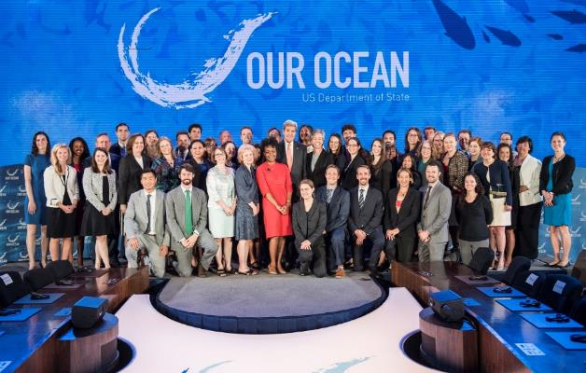
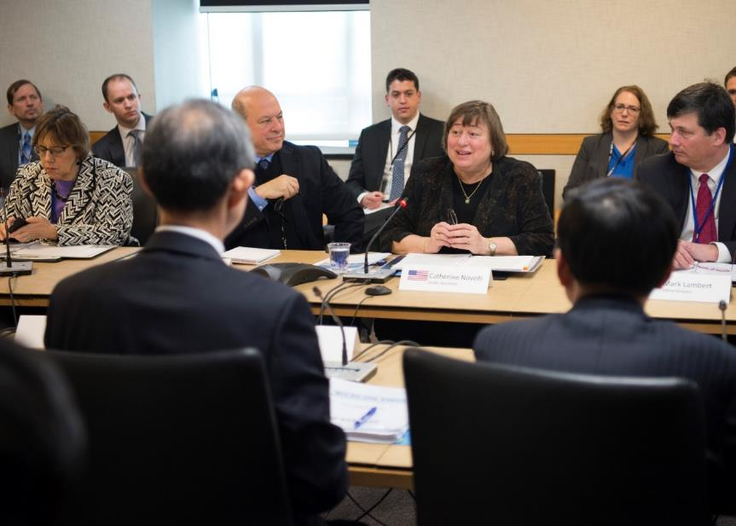
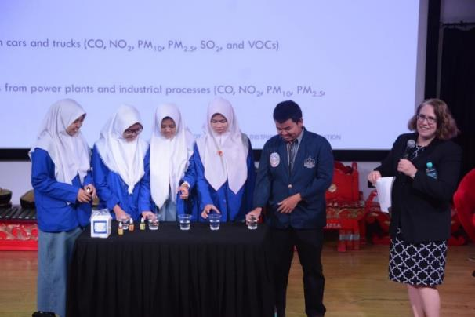
Foreign Affairs Officer (Energy, Science, and Technology)
Energy
Science & Technology
Science Envoys/Embassy Fellows
Women in STEM
Asia Pacific Economic Cooperation (APEC):
Policy Partnership on Women & the Economy
Energy Working Group
Mining Task Force
Policy Partnership on Science, Technology & Innovation
Automotive Dialogue
Chemical Dialogue
Notes:
Senior economic dialogue between US and Republic of Korea
Bilateral event with Embassy Jakarta to encourage girls to major in science

Slide 5
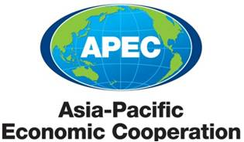
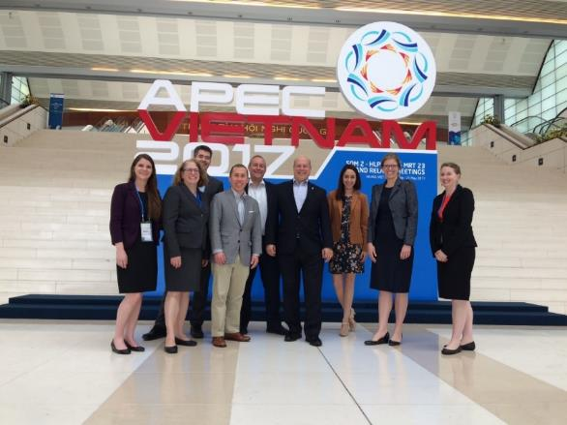

Slide 6
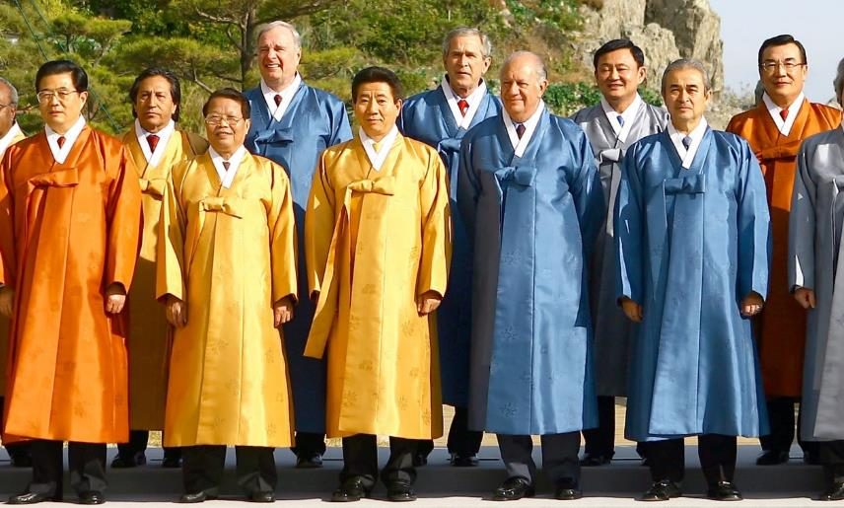
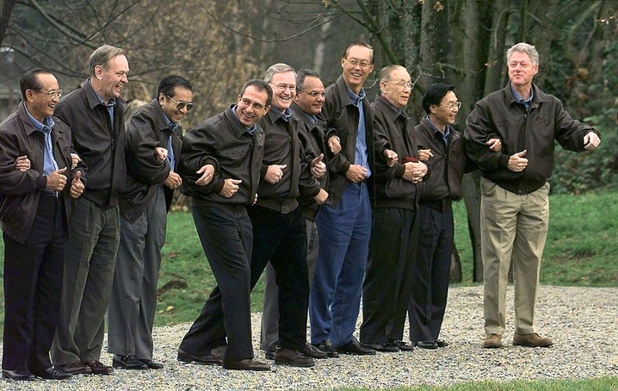
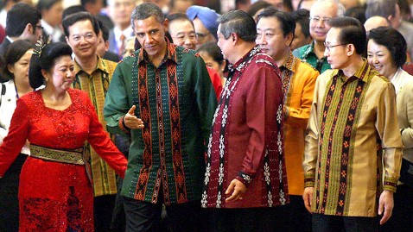
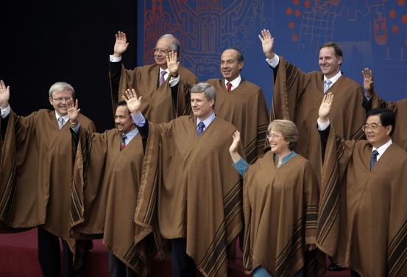
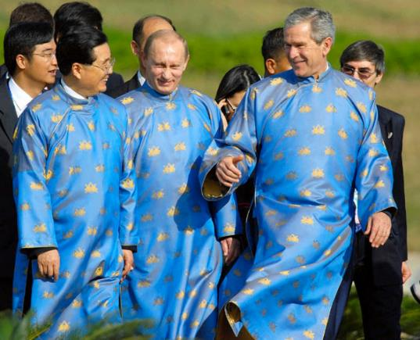
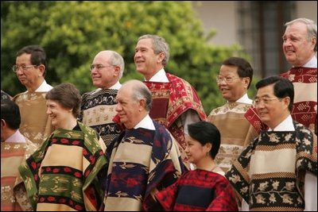
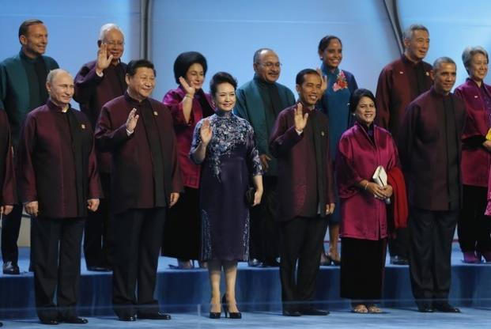
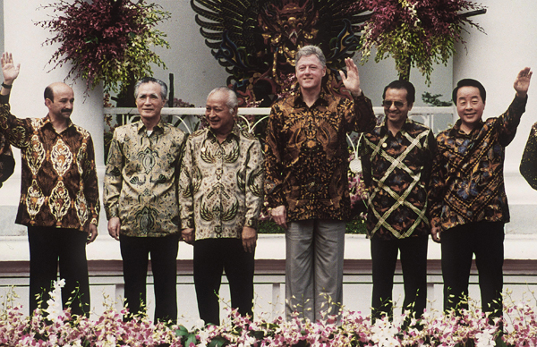
Notes:
Most people when they think of APEC , think of the stylish outfits and a once a year meeting. But in fact we are at the very core of every economic issue and hold over hundred meetings over the year.

Slide 7
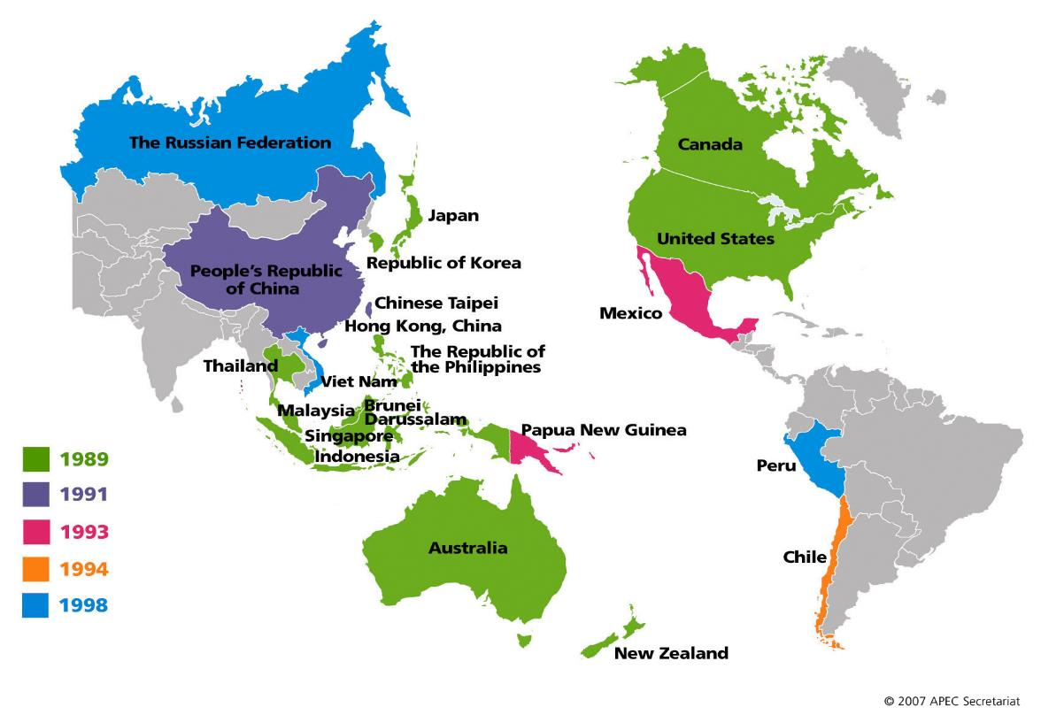
APEC Member Economies
Notes:
APEC is 28 years old and a diverse organization that is made up of 21 very different economies (large/small, EAP/WHA/EUR, developing at a different pace – economically, culturally and even politically).
It’s mission is to:
champion free and open trade and investment and accelerate regional economic cooperation
APEC is a non-binding and consensus based in nature – so we can influence the policies of 20 other members while maintaining our economic sovereignty, a key administration trade policy goal.
APEC members are referred to as “member economies” rather than countries as China, Chinese Taipei, and Hong Kong, China are all members. APEC members cooperate solely as economic, rather than political entities.
Venue where we have seen PRC pressure placed on Taiwan (spiked last year)
PRC opposes UN guests and references in APEC docs because of Taiwan presence at APEC

Slide 8
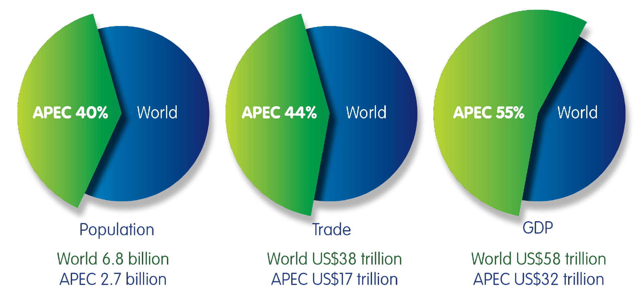
APEC’s Significance
Source: StatsAPEC, Key Indicators Database.
Copyright © 2013 APEC Secretariat
Notes:
Scale: we’re talking to 20 economies at once. Big bang for buck. APEC makes up 40% of the global population, 44% of global trade, and 55% of GDP.
Economic Benefits – APEC economies have three billion consumers. Nine of our top 15 export markets are APEC member economies. APEC members purchase 61 percent of U.S. goods exports.
U.S. work in APEC helps U.S. companies create jobs for Americans. Creating free & fair trade architecture, promoting better market access across the region for U.S. firms, and leveling the playing field behind the border through structural reform enhances U.S. competitiveness in the region and helps support job growth at home.
Commerce estimates more than 4.5 million jobs directly supported by exports to the APEC region.

Slide 9
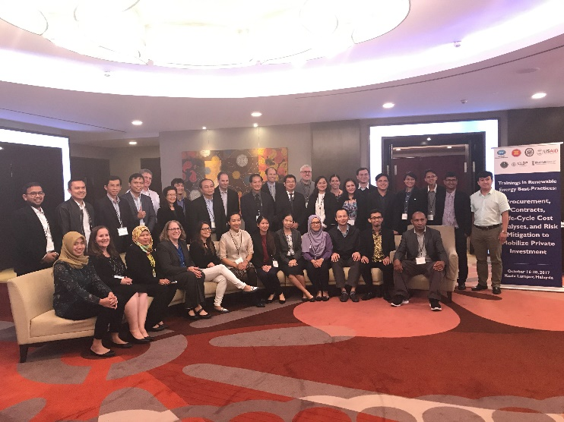
Energy Working Group
Expert Group on Energy Efficiency
Expert Group on Renewable Energy
Energy Working Group
Life-cycle Cost Analysis of Clean Energy in Kuala Lumpur, Malaysia (October 2017)
University Consortium to work on Energy Efficiency and Renewable Energy

Slide 10
Collaboration

Slide 11
Collaboration between Universiti Kebangsaan Malaysia and the Claremont Colleges
Philosophy, Policy, and Issues in Energy (UKM)
Environmental Chemistry (Claremont)
Students work collaboratively on clean energy projects comparing Malaysia and the U.S.
Smart Cities
Renewable Energy
Ethanol Blending in Gasoline
Energy, Environment, & Economics for Industry 4.0
Climate Change & Development
Communication
Skype, e-mail, Google docs
Challenging

Slide 12
Symposium at Universiti Kebangsaan Malaysia: May 15-18, 2018

Slide 13
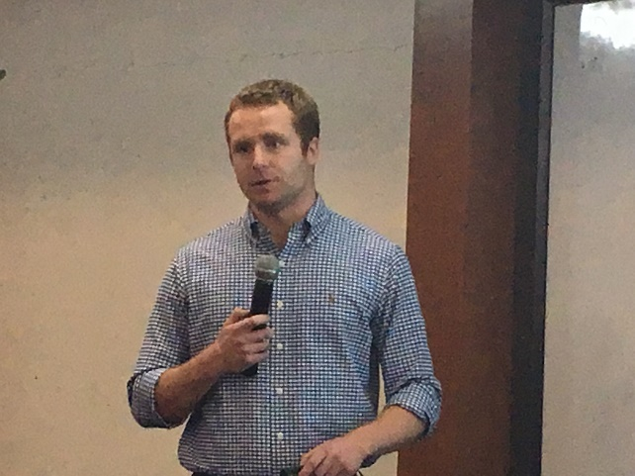
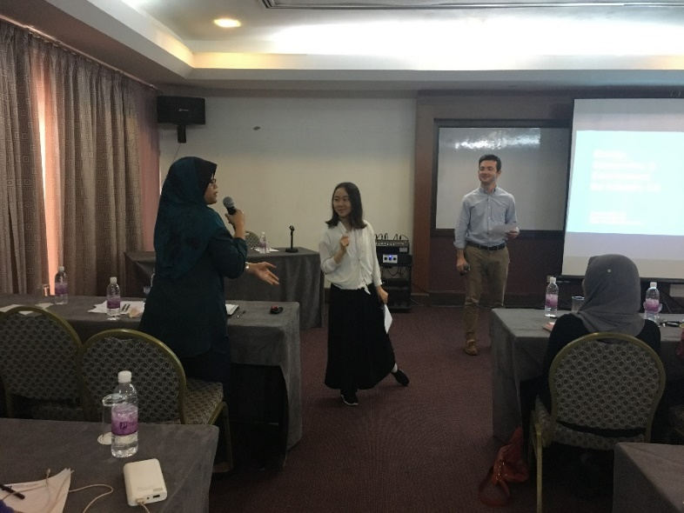
Claremont Student Talks at Symposium
Environmental Impact from Renewable Energy Technologies Systems
Environmental benefits for blending ethanol into gasoline for Kuala Lumpur and Los Angeles
Energy, Environment, and Economic Forecast Towards Industry 4.0

Slide 14
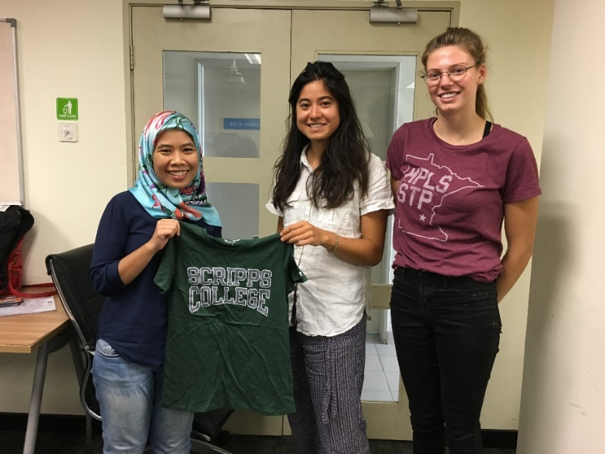
Students work on papers together

Slide 15
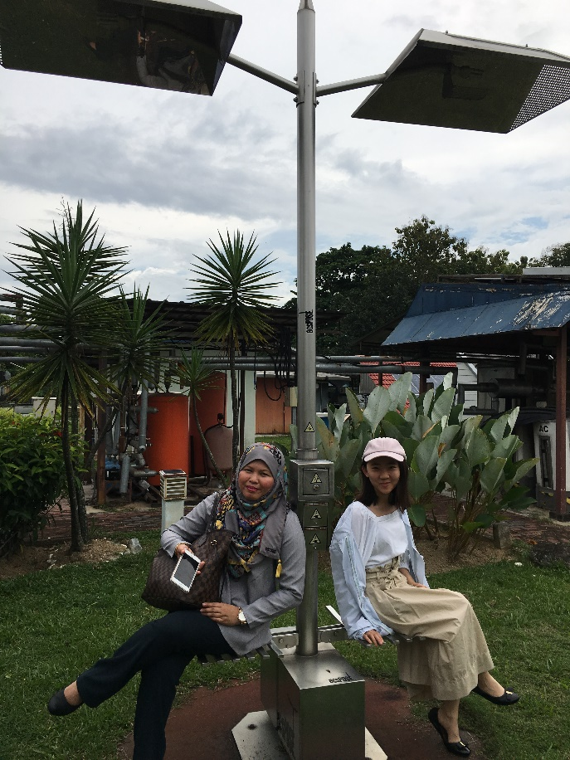
Environmental Field Trips

Slide 16
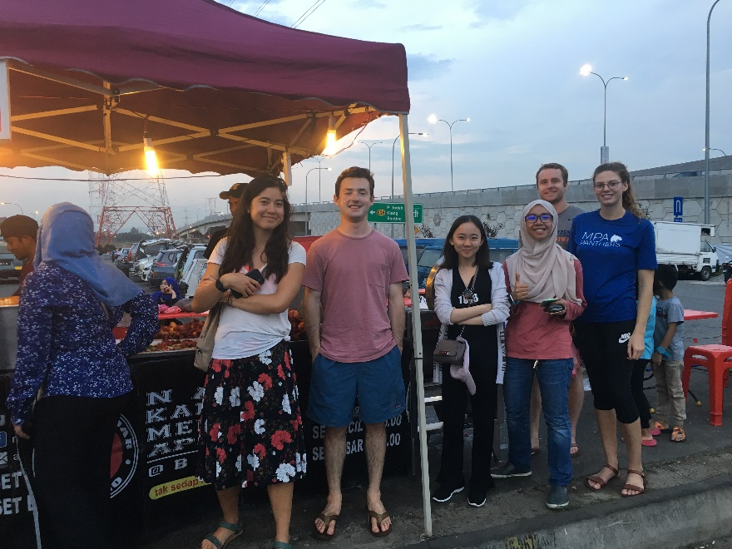
Cultural learning

Slide 17
Fall 2018
Classes taught at the same time
Tuesday at 7 pm in Claremont
Wednesday at 10 am in Selangor and Quezon City
Lecture for each other’s courses
Students collaborate on research projects together

Slide 18
Future Plans
In future hope to work on projects needed by the APEC Energy Working Group
Develop a network of Universities in APEC economies who collaborate on courses

Slide 19
Acknowledgments
Universiti Kebangsaan Malaysia
Dr. Norashikin Ahmed Ludin
Students in STSF 6033: Philosophy, Policy, & Issues in Energy
Claremont Colleges
Students in CHEM139: Environmental Chemistry
University of the Philippines
Professor Mili-Ann Tamayao
Future students in IE 298: Introduction to Life-Cycle Analysis
Funding
The National Academies of Sciences, Medicine, & Engineering
U.S. Department of State
Claremont EnviroLab Asia Program funded through the Henry Luce Foundation LIASE Program
Dean of Faculty Offices from Claremont McKenna, Pitzer, and Scripps Colleges

