Slide 1
The Global History Lab
Jeremy Adelman
Princeton University

Slide 2
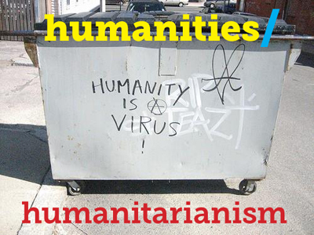
The Stage
Notes:
https://humafterlife.uchri.org/

Slide 4
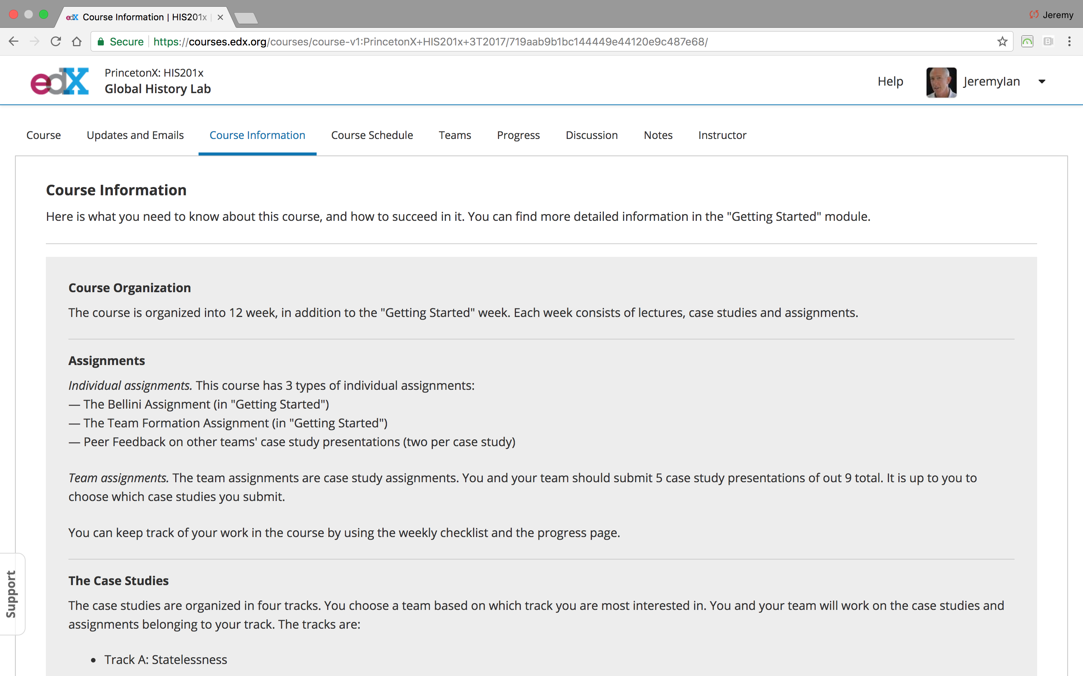
How Outsiders Help Insiders Think about the World

Slide 5
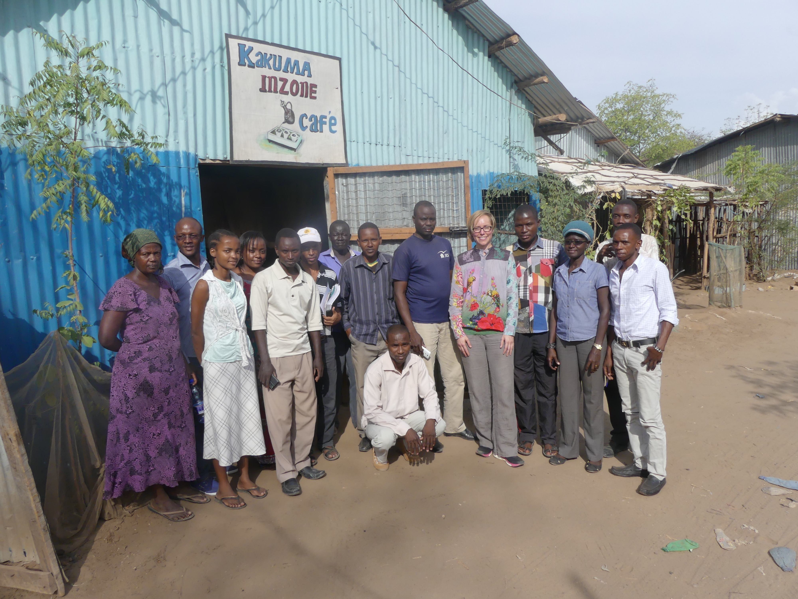

Slide 6
Skill 1:
Narrative mapping

Slide 7
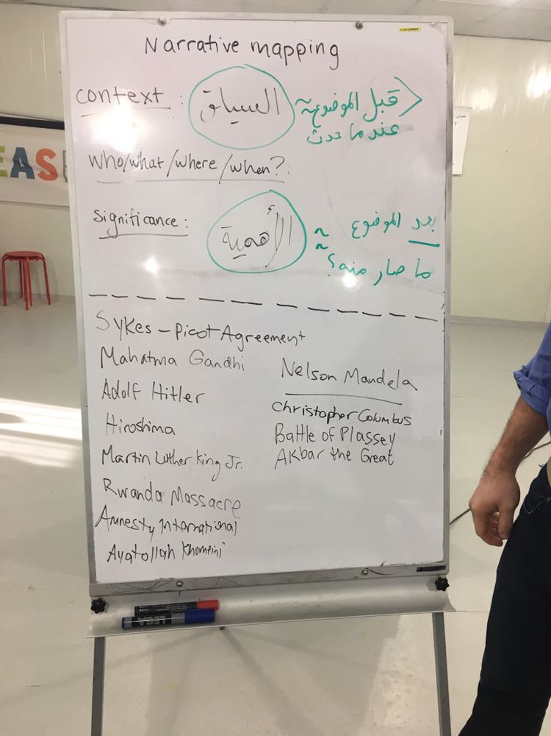
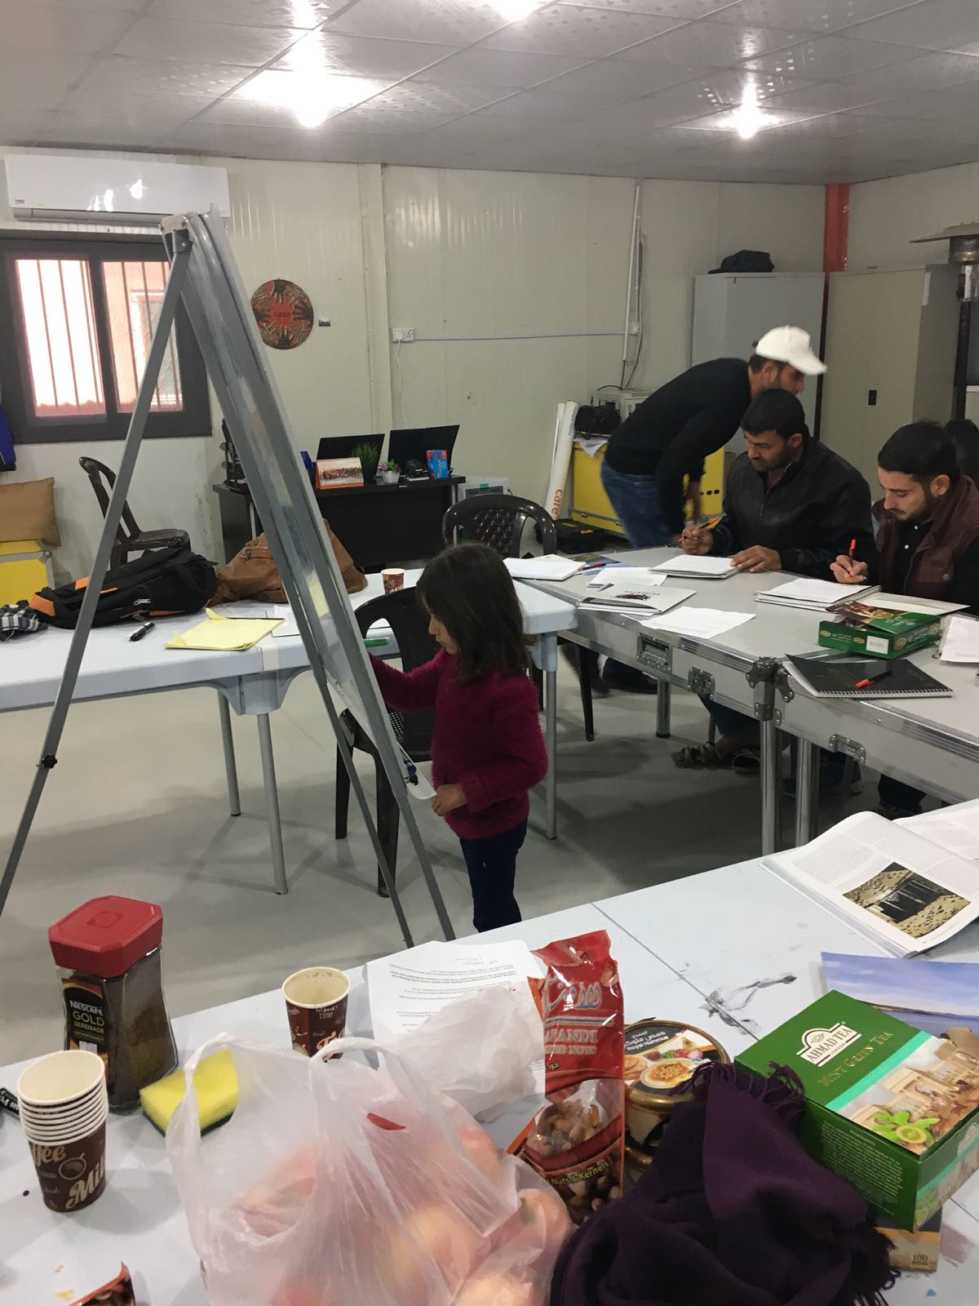
Narrative Mapping in Action

Slide 8
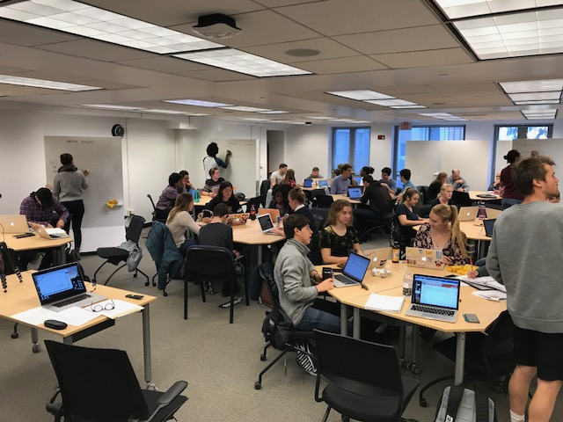
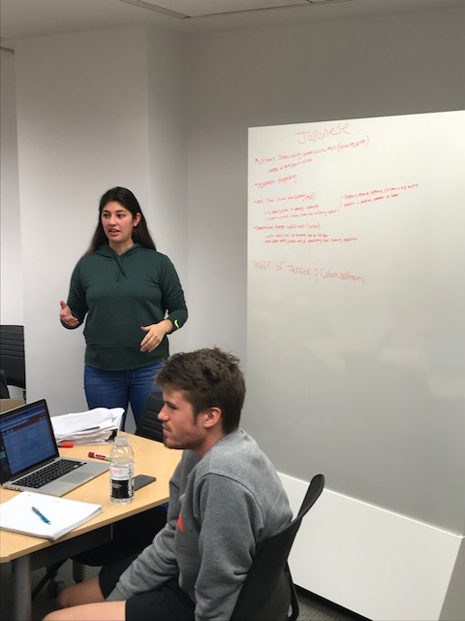
Narrative Mapping in Action 2.0

Slide 9
Skill 2:
Learning from strangers

Slide 10
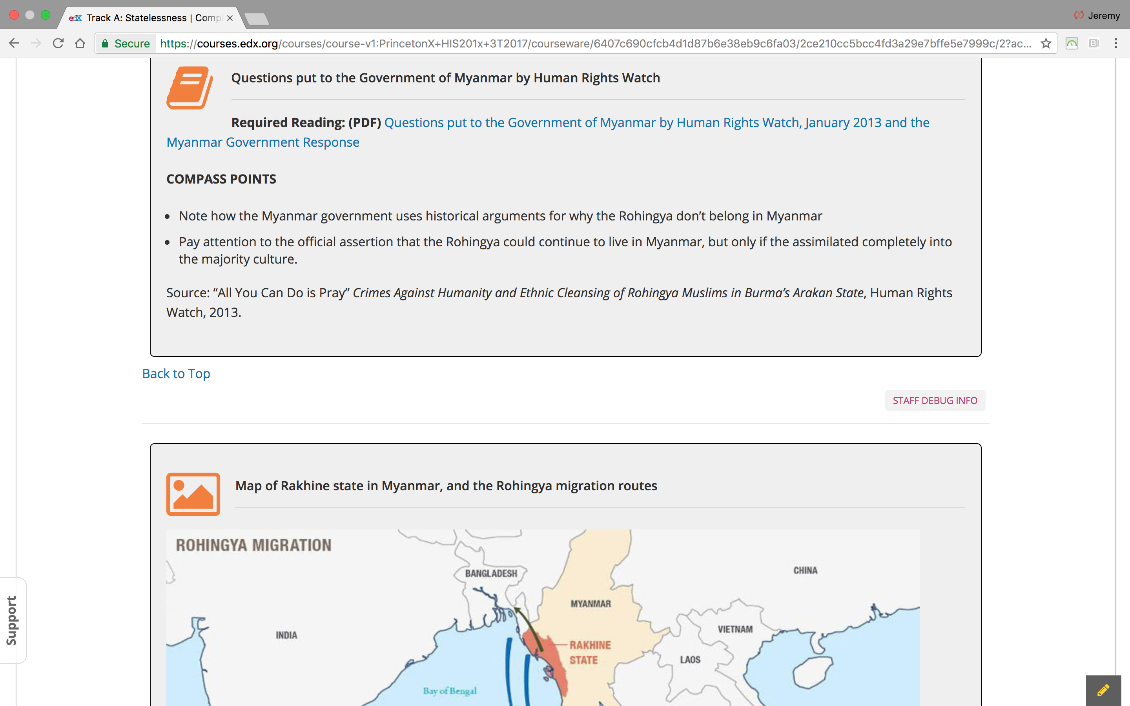
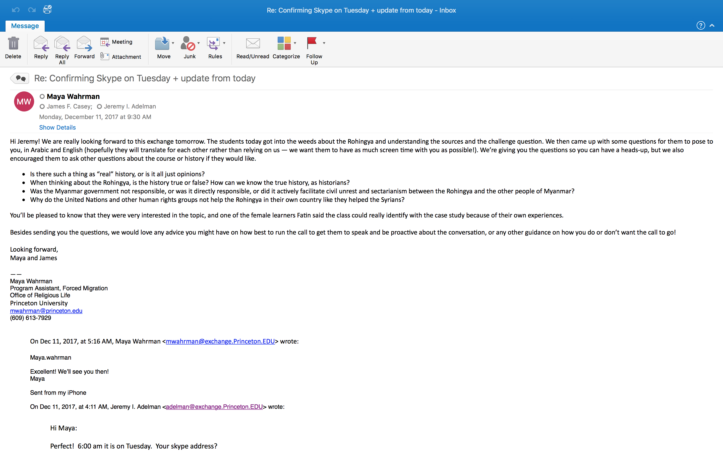
Last assignment

Slide 11
The Gallery

Slide 12
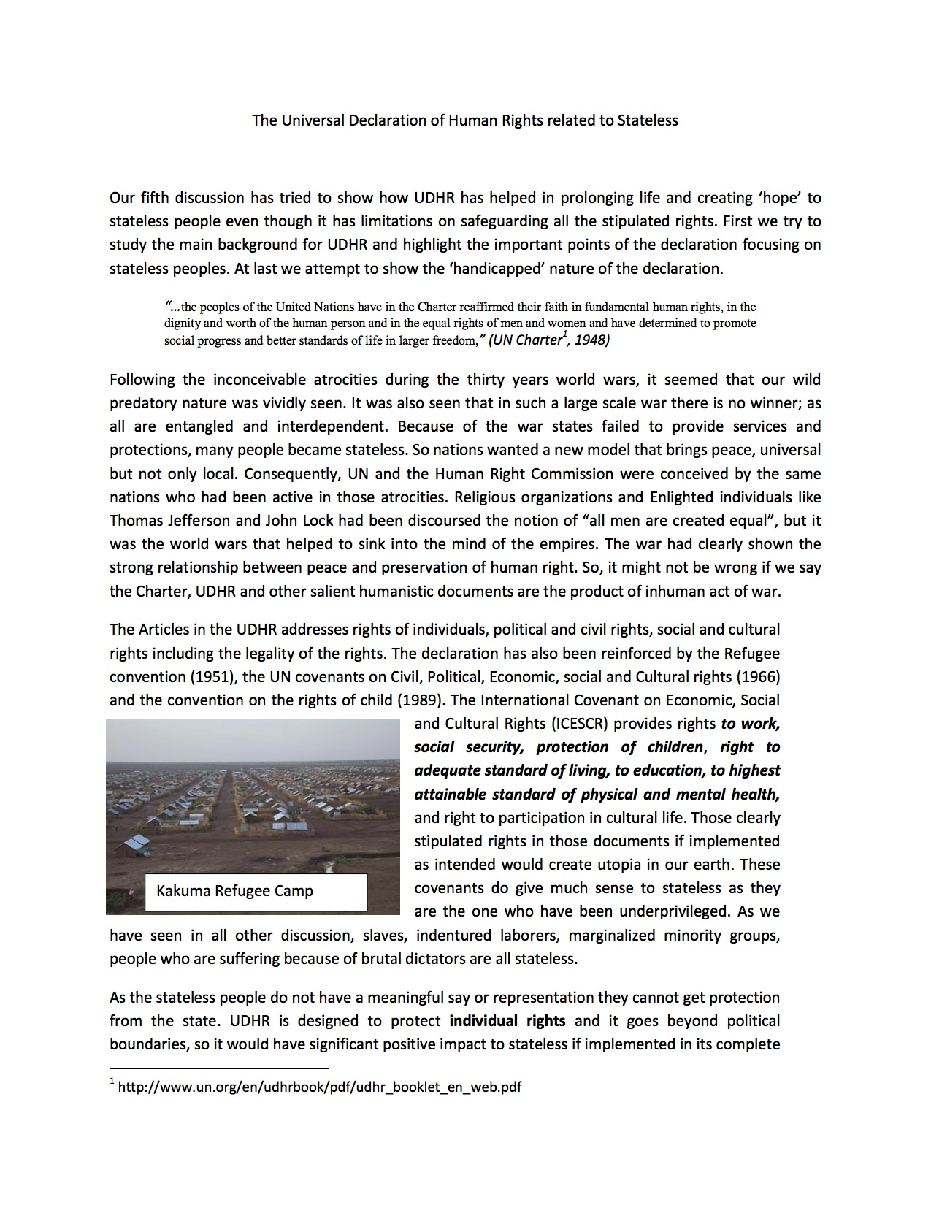
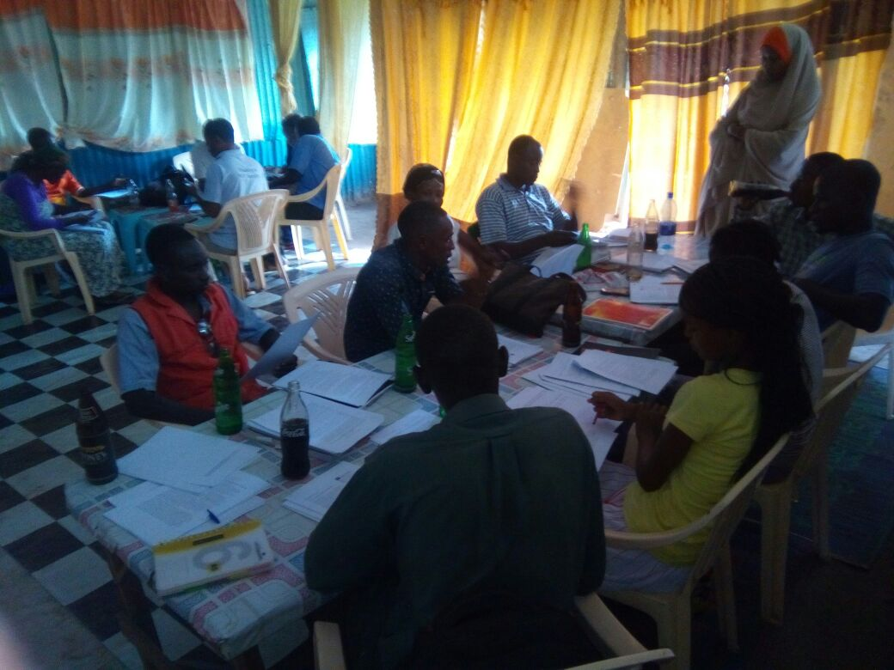

Slide 13
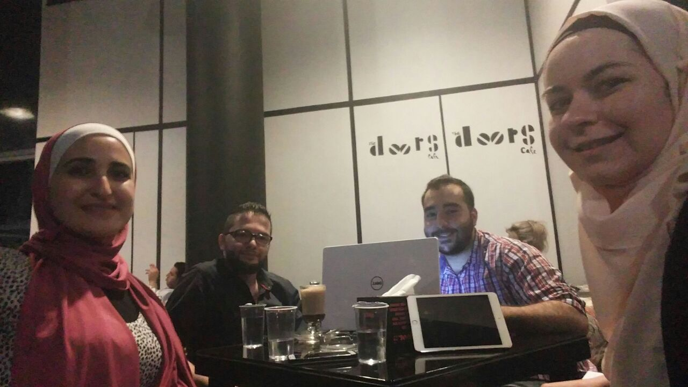

Slide 14
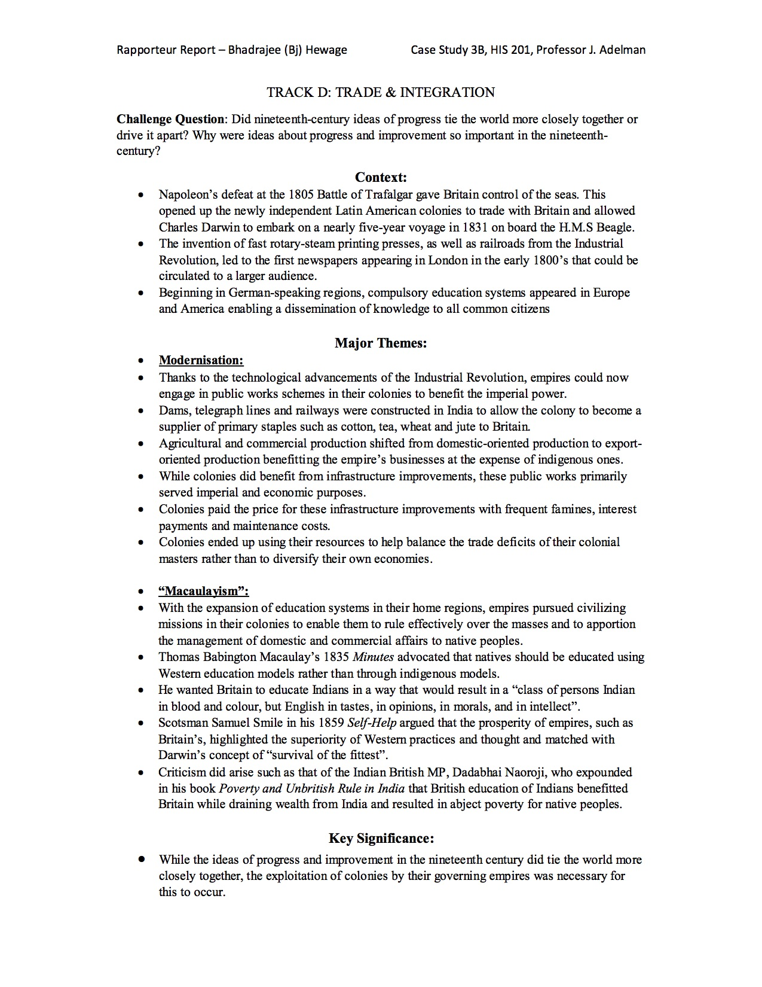
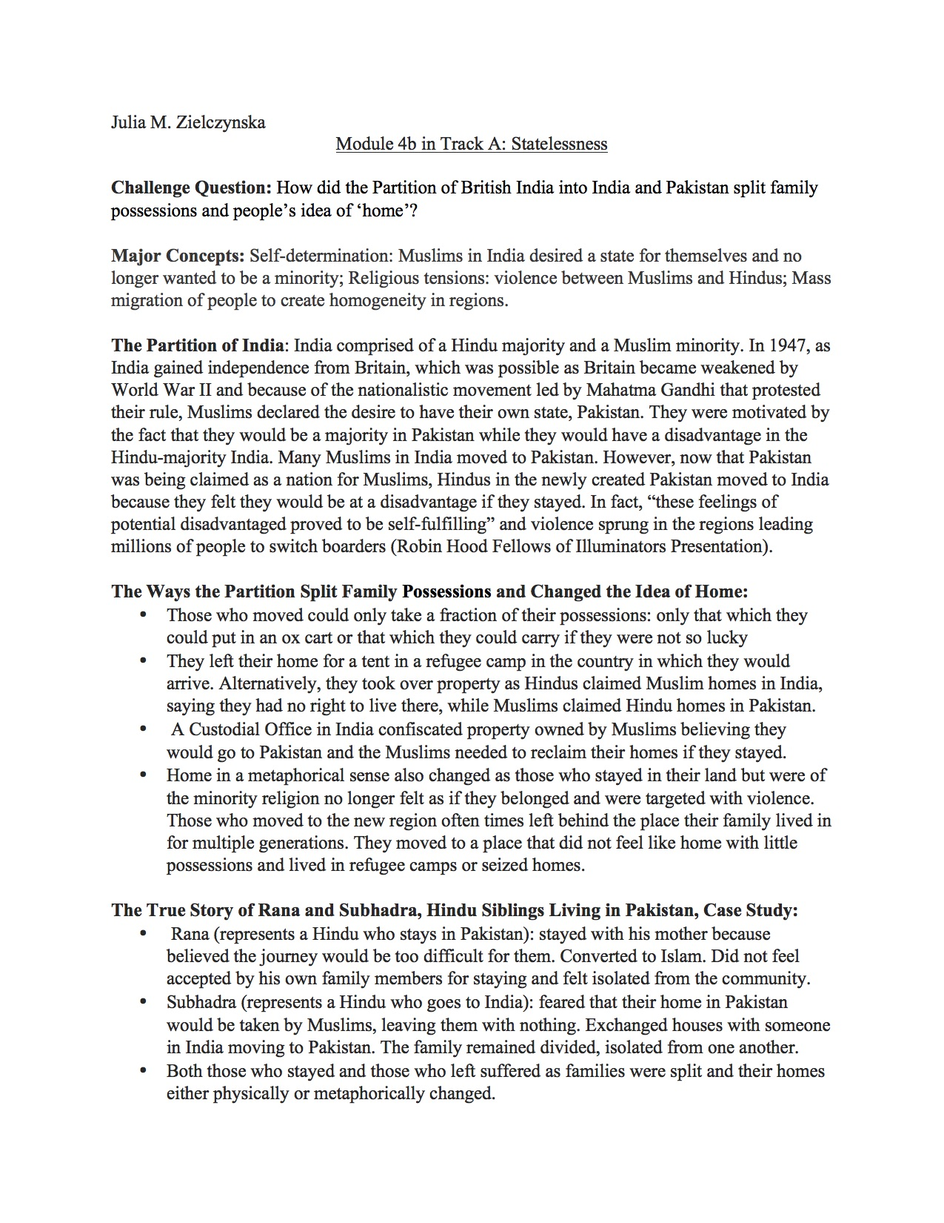

Slide 15
From Campus to Camps

