Slide 1
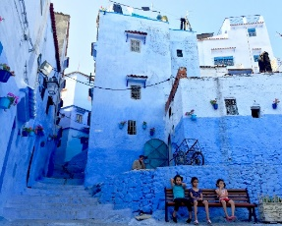
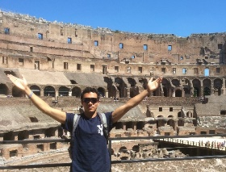
Study Abroad in a Connected World
JANE EDWARDS, YALE UNIVERSITY
ANTONIO GONZALEZ, WESLEYAN UNIVERSITY
VANITA SHASTRI, ASHOKA UNIVERSITY
TALYA ZEMACH-BERSIN, YALE UNIVERSITY
Globalizing the Liberal Arts, June 2-5 2018
Notes:
The divisions of CIPE, brought together in 2010
A single location, coordinated work
The photos are all by students (with their permission) – see our calendar!

Slide 2
Study abroad has changed and is changing
Student expectations
Institutional agendas
The emerging impact of this wave of globalization
Communications technologies
“Cultural Immersion” is not what it was – so what are we going to do about all this?
Globalizing the Liberal Arts, June 2-5 2018

Slide 3
Some different perspectives
Good pedagogy – what does this mean today in relation to study abroad and intercultural competence?
How do different educational systems grapple with these issues? Is it all the US model all the time?
Can we productively challenge accepted wisdom?
How can we use what we know?
Globalizing the Liberal Arts, June 2-5 2018

Slide 4
Five interesting readings
Carroll, Jude. Tools for Teaching in an Educationally Mobile World. New York: Routledge, 2015.
Global Learning: Crossing Majors, Borders and Backyards. Special issue of Peer Review 20/1 (Winter), 2018.
Grünzweig, Walter & Reinhart, Nana, eds. Rockin’ in Red Square: Critical Approaches to International Education in the Age of Cyberculture. Münster: Lit. Verlag, 2002.
Killick, David. Developing the Global Student: Higher Education in an Era of Globalization. New York: Routledge, 2015.
Womack-Wynne, Carly. Supporting a new breed of stewards to confront a changing reality. International Educator, May-June 2018: 21-26.
Globalizing the Liberal Arts, June 2-5 2018

Slide 5
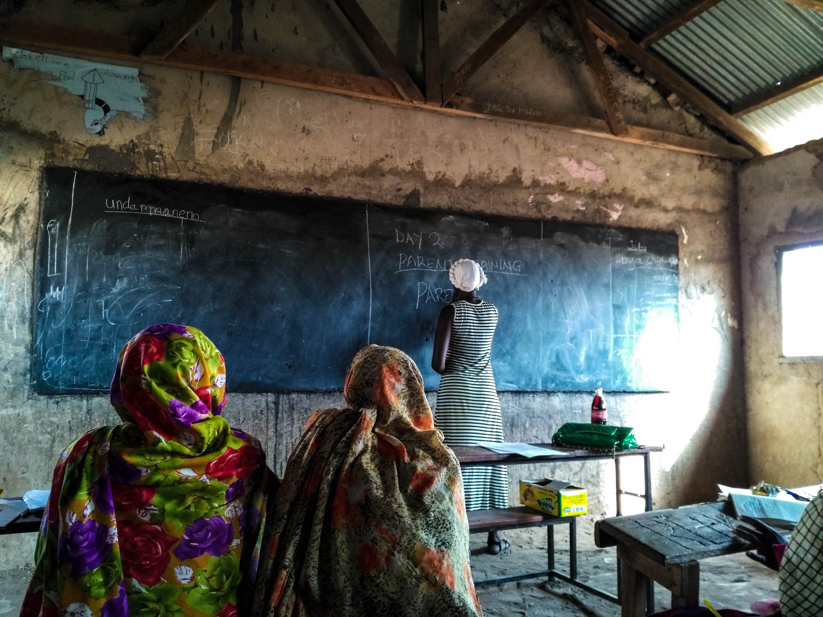
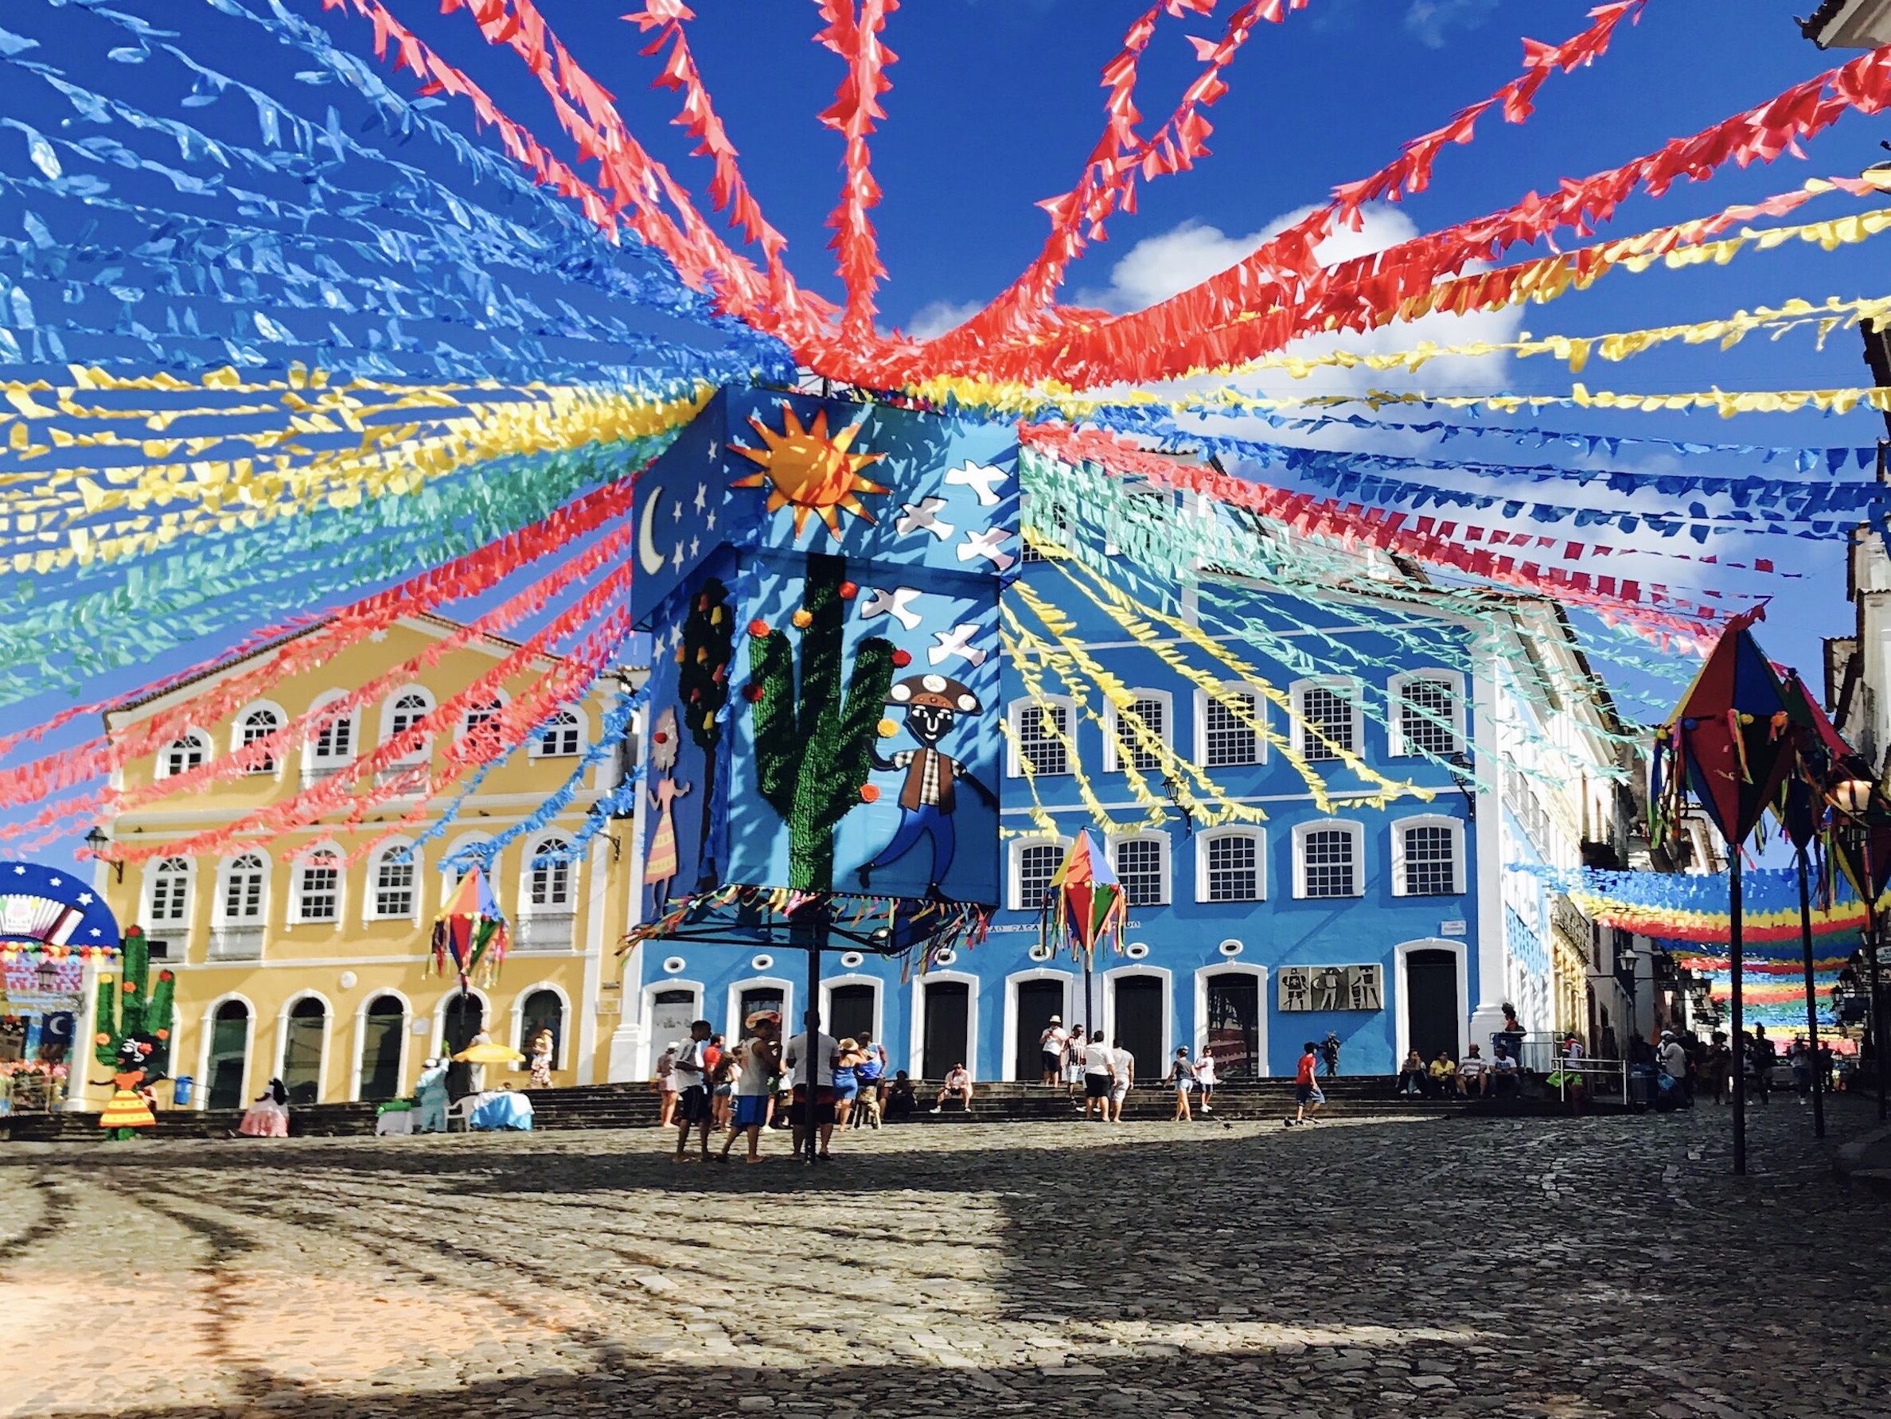
Over to my colleagues.
Globalizing the Liberal Arts, June 2-5 2018

