Slide 1
The Missing Link in Engineering Education: The Arts and Humanities

Slide 2
Presentation at
Globalizing the Liberal Arts Conference
Soka University
June, 2018
David E. Drew
Platt Chair in the Management of Technology
Claremont (CA) Graduate University

Slide 3
Explaining Einstein

Slide 4
After a few thousand Atlantic miles, one found Greenwich Village talking precisely the same language as Chelsea, and both having about as much communication with M.I.T. as though the scientists spoke nothing but Tibetan.
C.P. Snow
The Two Cultures

Slide 5
LSE Benefits
Broadening Participation
Improving the Design Process
Highlighting the Social Context

Slide 7
We believe that the greater workload engineering demands and the packed curriculum require students to choose between earning the engineering degree and participating in enriching educational experiences.
Lichtenstein, McCormick, Sheppard, and Puma, 2010

Slide 8
Several previous studies suggest, first, young people, and particularly women, want more interdisciplinarity in their engineering degree courses; and second, that many non-engineering students may have considered studying engineering if there had been more subjects from the humanities and the social sciences included.
GIEE, 2011

Slide 9
Hidden Talent Effective Teachers

Slide 10
Full many a gem of purest ray serene
The dark unfathom’d caves of ocean bear;
Full many a flower is born to flush unseen
And waste its sweetness on the desert air.
Thomas Gray
Elegy Written in a Country Churchyard

Slide 11
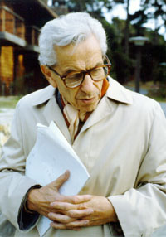
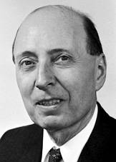
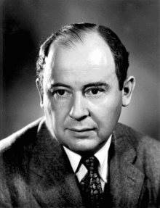
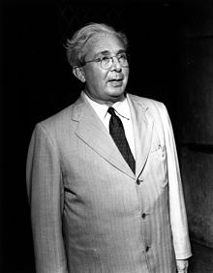
Mathematics
Physics
Paul Erdős
John Von Neumann
Edward Teller Eugene Wigner
Leo Szilárd

Slide 12
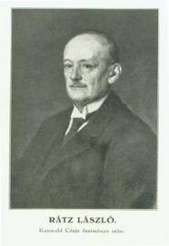
László Rátz

Slide 13
Thank You
http://www.davidedrew.com/
profdaviddrew@gmail.com

