Slide 1
Duke Kunshan Welcome and Introduction
Noah Pickus
Associate Provost & Senior Adviser, Duke University
Dean, Undergraduate Curricular Affairs
& Faculty Development, Duke Kunshan University

Slide 2
Overview
A 2000 student and 200 faculty residential liberal arts and sciences college outside Shanghai – starting at 265 students and scaling to 2000
A close connection between faculty and students from different regions of Asia and the world
An education equal in quality to that offered on Duke’s home campus, but different in form and scope
Opportunities for innovative and integrated forms of learning

Slide 3
General Education: The Words without Music
3 Common Core Courses
2-4 Language Courses (English/Mandarin)
3 Distributional Electives
1 Quantitative Reasoning Course

Slide 4
7 Animating Principles
Independence and Creativity
Collaborative Problem-Solving
Lucid Communication
Research and Practice
Wise Leadership
A Purposeful Life

Slide 5
Rooted Globalism
To cultivate informed and engaged citizens who are knowledgeable about each other’s histories, traditions of thought and affiliations; and skilled in navigating among local, national and global identities and commitments.

Slide 6
Key Structural Features
Shared
Integrated
Immersive
Flexible
Signature

Slide 7
COMMON CORE
China in the World
Global Challenges in Science, Technology, & Health
Ethics, Citizenship & the Examined Life
DIVISIONAL FOUNDATIONS
NATURAL SCIENCE
Math Foundations 1 - 2
Integrated Science 1 - 4
Scientific Writing & Presentations
ARTS & HUMANITIES
The Art of Interpretation: Written Texts
The Art of Interpretation: Images & Sound
SOCIAL SCIENCE
Foundational Questions in Social Science
Introduction to Research Methods

Slide 8
Key Structural Features
Shared
Integrated
Immersive
Flexible
Signature

Slide 9
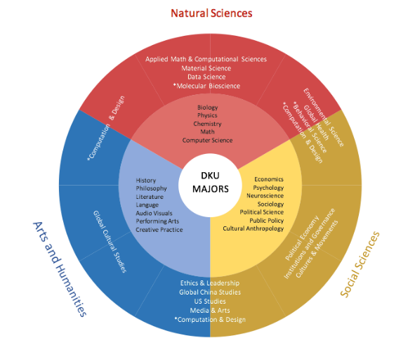
Undergraduate Majors

Slide 10
Key Structural Features
Shared
Integrated
Immersive
Flexible
Signature

Slide 12
Key Structural Features
Shared
Integrated
Immersive
Flexible
Signature

Slide 13
Signature Work

Slide 14
Year 1
Year 2
Year 3
Year 4
Language
Common Core: 3 courses
Language: 4 courses
Major: Foundation, Interdisciplinary, Disciplinary, Signature Work*: 16-19 courses
Concentrations
Electives: 8-13 courses
*Signature Work: Thematic Courses, Experiential Education, Capstone Project

