Slide 1
Making a School: a case study in globalizing the liberal arts curriculum
Rosetta Marantz Cohen
Smith College
Director, Lewis Global Studies Center

Slide 3
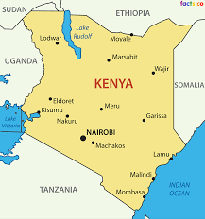

Slide 4
Givens that supported and legitimized the process
Co-teaching with a Kenyan faculty person at Smith
Contacts on the ground in Kenya
Authentic faculty commitment to make the actual school

Slide 5
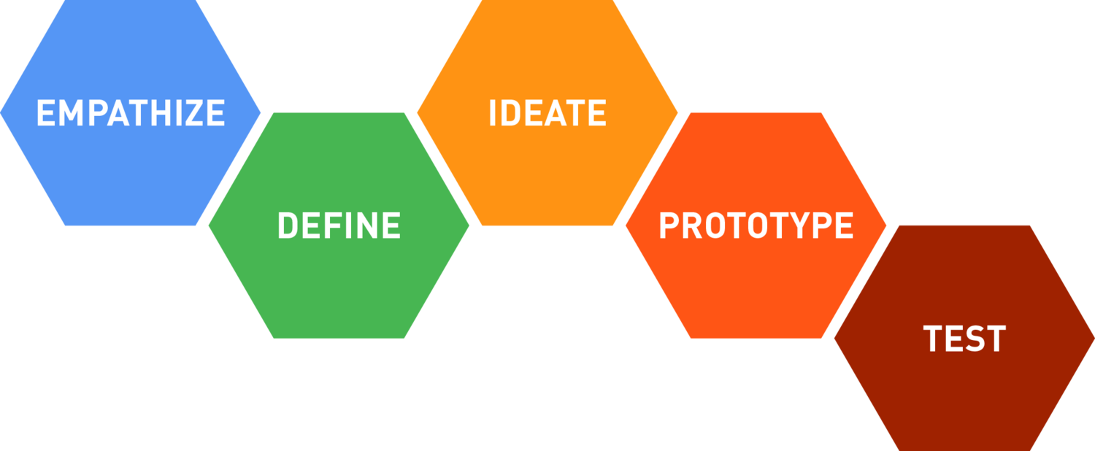
The Design Thinking Process
Notes:
Used the design thinking process: empathizing emerges from deep prior reading—in this case…--defining the problems that need solving, brainstorming and research ideal solutions, working prototypes and then testing them by sending them to experts in the field and using their feedback to earlier stages of the process.

Slide 6
Teams linked to Kenyan consultants
Mission, admissions and marketing (website, marketing plan)
Schedules and regulations (handbook and all non-academic policies)
Governance and personnel (hiring, board membership, etc.)
Curriculum (alternative approaches/Kenyan state curriculum)
Budget and fundraising (identifying donors, drafting a base budget)
Site-planning: (mapping, site analysis and building)

Slide 7
Zoomed and in-person Kenyan expertise
Enoch Wambua: Senator from Kitui County, Kenya
Anne Mawathe: Kenyan journalist; documentary film maker and advocate for girls
Linda Dounia Rebeiz: ALA grad; currently curriculum developer at ALU, Mauritius
Elishibah Msengeti: Head of Student Life, M-pesa Academy, Nairobi
Our on-site expert:
Hilda Nalwanga: ALA grad; class Teaching Assistant

Slide 8
Site Planning Essential Parameters
Distance from the cities/commercial areas
Distance from the main roads
Infrastructure
Distance from nearby facilities and local communities
Distance from stream/water source
Soil Condition
Parameters
Environmental
Local Climate
School design
Evaluation
Sound Level & Air Pollution(future)
Animals and biodiversity (future plan)
Physical
Land Slope and Elevation
Flood Prone
Notes:
Site planning worked out of the GIS mapping center at Smith, gathering data to situate the school on the tract of land—mapping out the distance to various key resources, calculating angles of the sun for energy conservation, studying the soil conditions for gardening, the septic system, the wells, etc. Then using 3-D technology to design the building itself

Slide 9
Curriculum: Overview
Framing our Curriculum around girls’ leadership and empowerment
Organizational Process
Merging Ideas, Values, and Priorities
Kenyan Curriculum
Lower Secondary
Upper Secondary
Learning Outcomes
Innovative Subjects
Pedagogy
Inclusive Classrooms
Assessments and Grading
Next Steps and 5 Year Plan
Notes:
overview of the first iteration of our school’s curriculum framework. Began with the general structure of the newly Kenyan curriculum, focusing on lower and senior secondary courses and learning outcomes. The group them looked at ideal curriculm for leadership empowerment—including the Oprah Winfrey School, the African Leadership Academy, schools in the United States like Desert Academy in Santa Fe. They looked at IB curriculum, project based schools, progressive schools like Simon’s Rock, and others. Then, Zoe and Bella will discuss our school’s pedagogical approaches to working within the confines of the Kenyan Curriculum, highlighting our approaches to incorporating progressive pedagogies and aligning ourself with our school’s values. And finally, we will collectively present general ideas for our five-year plan.

Slide 10
Budget and Marketing: Individual Giving Program
Membership based
Target demographics
Kenyans living abroad
Five college community
Communications
Email and paper mail
Website page
Social media
Shareable media
Costs
Website
Donor and communication management
Physical mailings
Development staff
Notes:
Focus particularly on the marketing and fund-raising, focusing on what they called “ethical funders” which ultimately became a list of philanthropic donors drawn largely from the Kenyan and pan-African diaspora.

Slide 11
The benefits of globalizing coursework in a class like this:
Iterative process of Design Thinking reinforces the key lesson that knowledge is flexible, subject to revision
Working on “real problems” promotes unprecedented investment in students
Underscores the subjectivity of cultural understanding

Slide 12
Liabilities of globalizing coursework
Time and logistics
Exporting a hegemonic perspective, even unwittingly. Even with all the prior givens, students still felt uneasy about the work, e.g. their privilege and questionable authority for creating solutions to problems they had only studied second-hand.

Slide 13
Lingering questions
How do we justify and legitimize the work of privileged, western students on real-world problems in the developing world?
How much prior knowledge is sufficient to make collaboration authentic, meaningful, and useful?

