Slide 1
Overview of the SUA
By Bryan Penprase
Dean of Faculty, Undergraduate Program,
Soka University of America

Slide 4
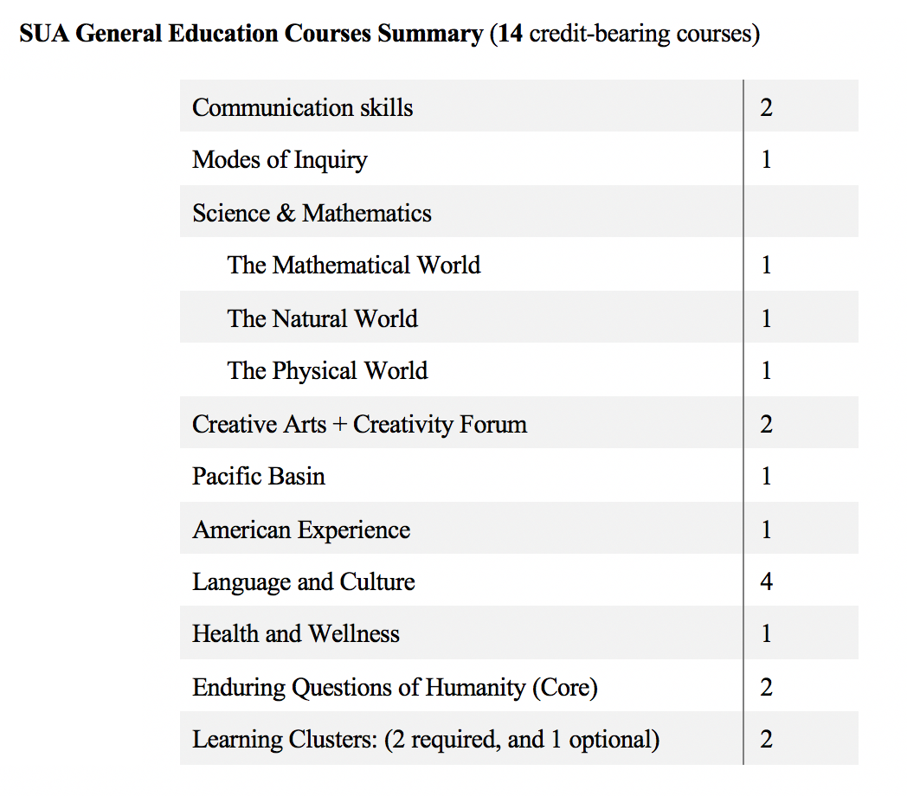

Slide 15
