Slide 1
Globally Engaged Institutions: Lists of Initiatives or Institutional DNA?
Patti McGill Peterson
Senior Fellow, Center for Internationalization and Global Engagement
American Council on Education

Slide 2
TERMS
Globalization – interaction among people and organizations of different nations, frequently driven by economic and political interests. This process impacts culture, political systems, economies, and the environment. It is not a new phenomenon but now a more intensive one.
Internationalization – the process of integrating an international, intercultural, or global dimension into the purpose, functions and delivery of higher education.
Global Engagement – the ways in which institutions of higher education reflect their relationship with the rest of the world through various dimensions of institutional activity.
Global Learning – allows students to explore what connects them to the rest of the world; enables them to engage with complex international and global issues and examine links below their own lives and societies, cultures and issues throughout the world.

Slide 3
Comprehensive Internationalization

Slide 4
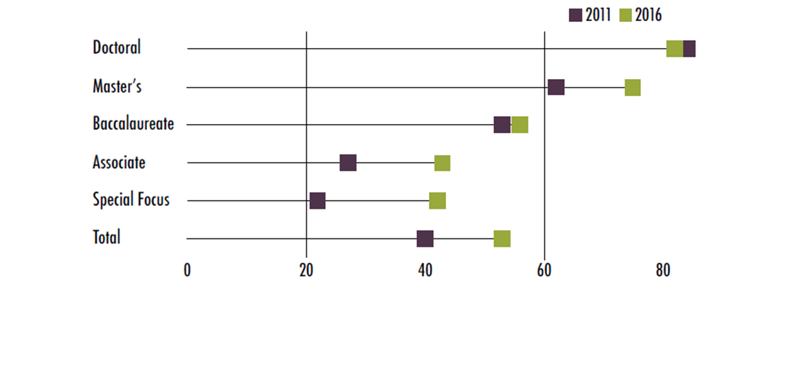
Administrative Coordination
Percentage of institutions with a full-time administrator who oversees multiple internationalization activities or programs

Slide 5
Study Abroad
Percentage of institutions indicating education abroad participation has increased, decreased, or remained the same in the last three years (2016)

Slide 6
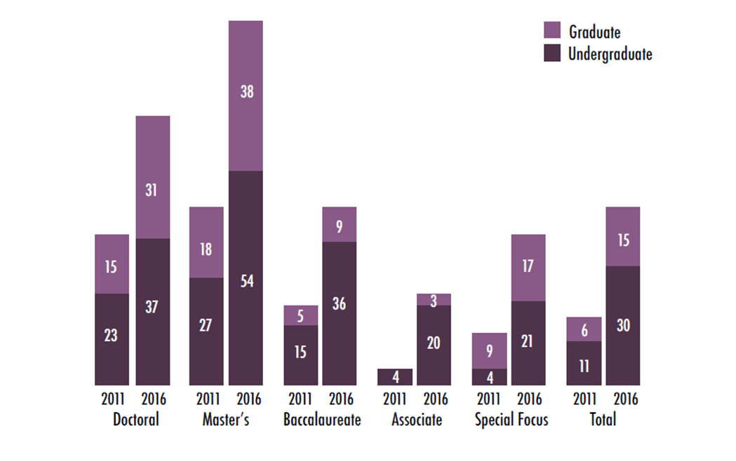
International Students
Percentage of institutions hiring overseas recruiters to recruit international students

Slide 7
Internationalizing the Curriculum
Percentage of institutions engaged in efforts to internationalize the undergraduate curriculum

Slide 8
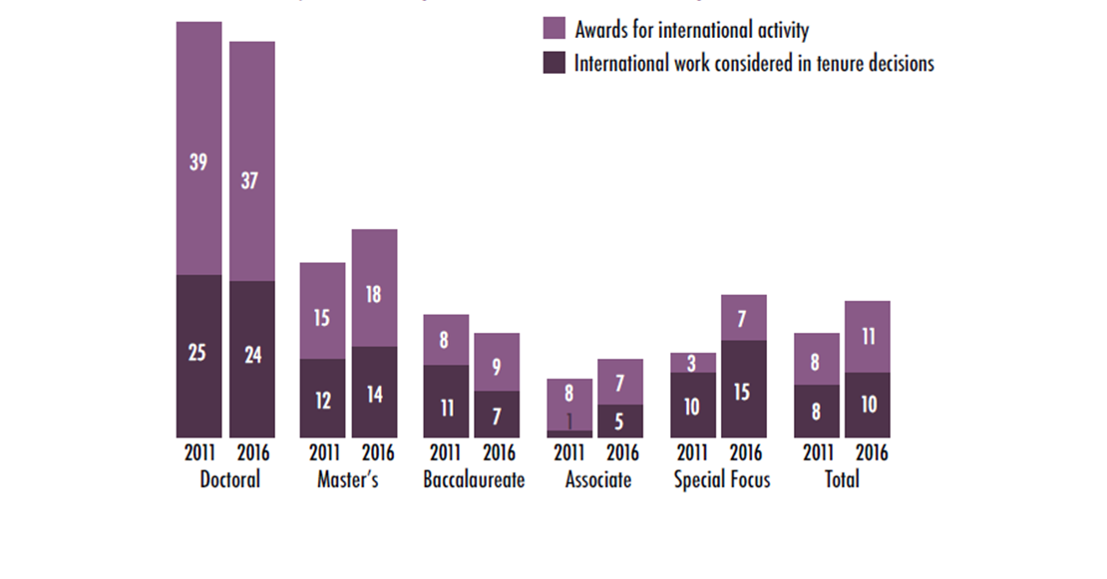
Faculty Awards and Tenure
Percentage of institutions that consider international work or experience in promotion and tenure decisions and/or offer faculty awards for international activity

Slide 9
Global Learning Objectives
Knowledge
Knowledge of world geography, conditions, issues and events.
Awareness of the complexity and interdependency of world issues and events.
Understanding of historical forces that have shaped the current world system.
Knowledge of one’s own culture and history.
Understanding of the diversity of values, beliefs, ideas, and worldviews.
Skills
Technical skills to enhance students’ ability to learn about the world (e.g., research skills).
Critical and comparative thinking, including the ability to think creatively and integrate diverse cultural frames of reference.
Communication skills, including the ability to use another language effectively and interact with people from other cultures.
Coping and resiliency skills in unfamiliar and challenging situations.
Attitudes
Tolerance for ambiguity and unfamiliarity.
Respect for and appreciation of personal and cultural differences.
Empathy and the ability to see multiple perspectives.
Self-awareness about one’s own identity and culture.
American Council on Education (ACE)

Slide 10
Global Learning Value Rubric
A critical analysis of and an engagement with complex, interdependent global systems and legacies and their implications for people’s lives and their sustainability Global Self-Awareness Perspective taking Cultural Diversity Personal and Social Responsibility Global Systems Knowledge Applications
American Association of Colleges & Universities (AAC&U)

Slide 11
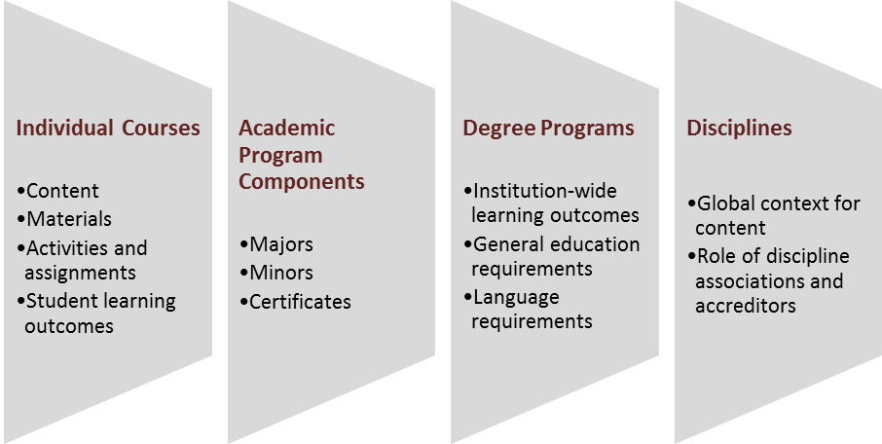
Curricular Elements for Global Learning
Notes:
THE OTHER 90% Curriculum As Anchor There is a “DUH!” Slide How do we assure that all students have access to global learning? The quintessential element of internationalization CIGE has treated it as a priority Discuss highlights of IIA series Central to Comprehensive Internationalization Not a single model Again, calls for comprehensive approach. Example of St. Lawrence
1st year majors Global infusion study abroad
Senior capstone thesis

Slide 12
Faculty Development
Percentage of institutions offering faculty development funding, programs, and opportunities
2011
2016
40
30
30
21
19
30
15
23
25
1 5
12
11
Studying or conducting research abroad
Teaching abroad
Improve language skills
Internationalizing courses
Using technology for global learning
Assessment of global learning outcomes

Slide 13
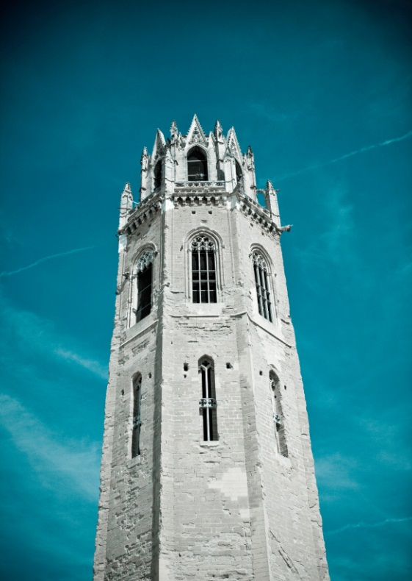
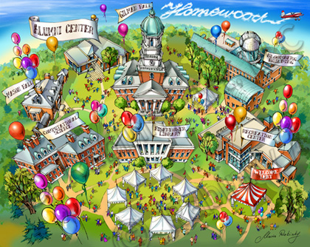
Parameters of Institutional Mission
Notes:
Parameters of Institutional Mission
Do we have institutions that are responsive to global learning? Are they ivory towers, unresponsive to the world around them? Are they out of focus, trying to be all things to all purposes? Either case presents a challenge to their responsibility for global learning Who determines institutional mission? - Classic case – University of Wisconsin, Madison * Q. What is your mission? Who decided it? *STOP Define terms *Q. Globalization v. Internationalization

Slide 14
“The purpose of college is not just to transmit skills. It is also to widen your horizons, to make you a better citizen, to help you evaluate information, to help you make your way through the world…..”

