Slide 1
Private Liberal Arts College in Central Iowa
1650 Students (20% International Students)
Need Blind Admission (and need met for all students)
Social Justice roots and history
60% of our students study abroad/away for the semester
Faculty-Governance

Slide 2
Road to Comprehensive Internationalization at Grinnell
Internationalization formally began in 2007 and spanned two presidential terms
Global Learning Assessment – first phase
Comprehensive Internationalization – second phase

Slide 3
Road to Comprehensive Internationalization at Grinnell
Global Grinnell Task Force (2014-2017)
Incorporate global learning goals and priorities into college statement and mission.
Build a stronger, more integrative structure to lead, sustain, and evaluate international education.
Define strategic partnerships or “nodes” of engagement.

Slide 4
Road to Comprehensive Internationalization at Grinnell
Creation of new Institute for Global Engagement 2017
Centralize Off-Campus Study, Language Learning Center, faculty led programs, international visiting scholars
Vice-President for Global Engagement, Senior International Officer (SIO and rotating faculty position)
Senior Director of Global Initiatives (Deputy SIO and long-term director)
Director, Language Learning Center

Slide 5
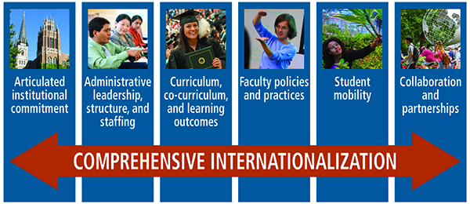
Road to Comprehensive Internationalization at Grinnell
5 Strategic Priorities
International Students
Study Abroad
Curriculum
Co-curricular activities
External Partnerships

Slide 6
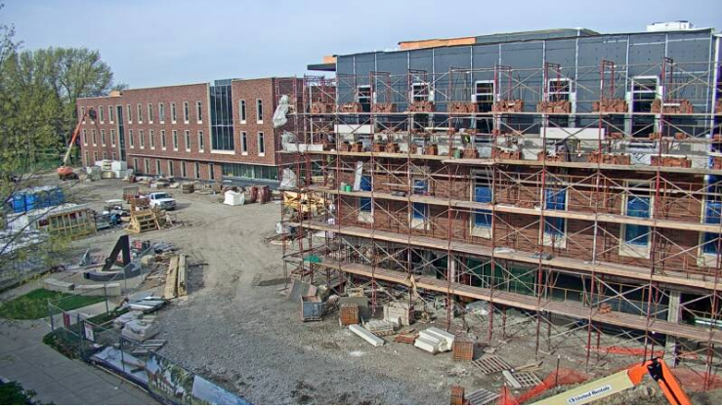
Partnering of Study Abroad and International Students
International Students currently under Student Affairs
New Building Location will physically combine offices

Slide 7
Study Abroad- Next Steps
Study Abroad as pathway to Comprehensive Internationalization
Using faculty site visits strategically
Bringing speakers and consultants to campus

Slide 8
Curricular/Co-Curricular Next Steps
Study Abroad as pathway to Comprehensive Internationalization
Using faculty site visits strategically
Bringing speakers and consultants to campus
Expanding International Internship Program
Expanding Research Abroad opportunities

Slide 9
Partnerships/Collaborations: Next Steps
Focus on creating more “strategic nodes of engagement”
ex: Nanjing/SE China (40 year partnership)
Identify institutions that can benefit multilateral exchange opportunities
Global Symposium Spring 2019

Slide 10
Global Learning Goals- Next Steps
Students pursuing global learning should develop the ability to:
Understand and experience a place outside of their home country, using a complex set of skills and knowledge that represents the diversity of learning experiences at Grinnell College, including the study of languages. “Place” can be defined broadly as a city, region, ecosystem, or other geographic entity, and it includes the people who reside in that location.
Understand a global process or system (e.g. climate change and sustainability, migration, development, international trade, linguistic patterns, religious practices, literary or artistic traditions, colonialism) that connects different places in the world.
Identify a topic, issue, practice, custom, idea and/or historical debate on which people in different parts of the world have varying opinions or attitudes and ways of expressing them, and then be able to explain the reasons behind these differences.
Understand their home or home country in global terms. That is, students should understand the relationships between the home country and other places in the world, and students should recognize how particular characteristics of the home country are practiced differently in other places.
Navigate societies, work in cultures, and understand and speak languages other than their own.

Slide 11
Road to Comprehensive Internationalization at Grinnell
5 Strategic Priorities
International Students
Study Abroad
Curriculum
Co-curricular activities
External Partnerships

Slide 12
Study Abroad
Co-Curricular
Faculty Governance/
Administration
Curricular
Student Learning
Senior Leadership
International Student Enrollment (Student Affairs)
Exchange Partnerships
Admissions/
Development/Alumni
Institute for Global Engagement (Acad Affairs)
Positionality
Diplomacy
Relationships

