Slide 1
FIU’s Global Learning Medallion

Slide 2
Creative: Layout and Organization

Slide 3
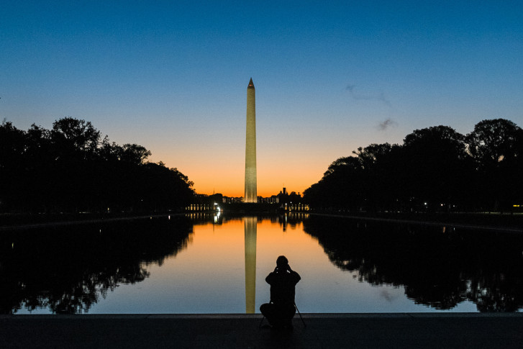
Standardized: Reflection Questions
Discuss changes in your global awareness, perspective, and engagement) as a result of overall participation with global learning at FIU.
Detail your plans to act as a global citizen post-graduation in your personal, academic, and/or professional life.
Name specific skills you gained or improved.

Slide 4
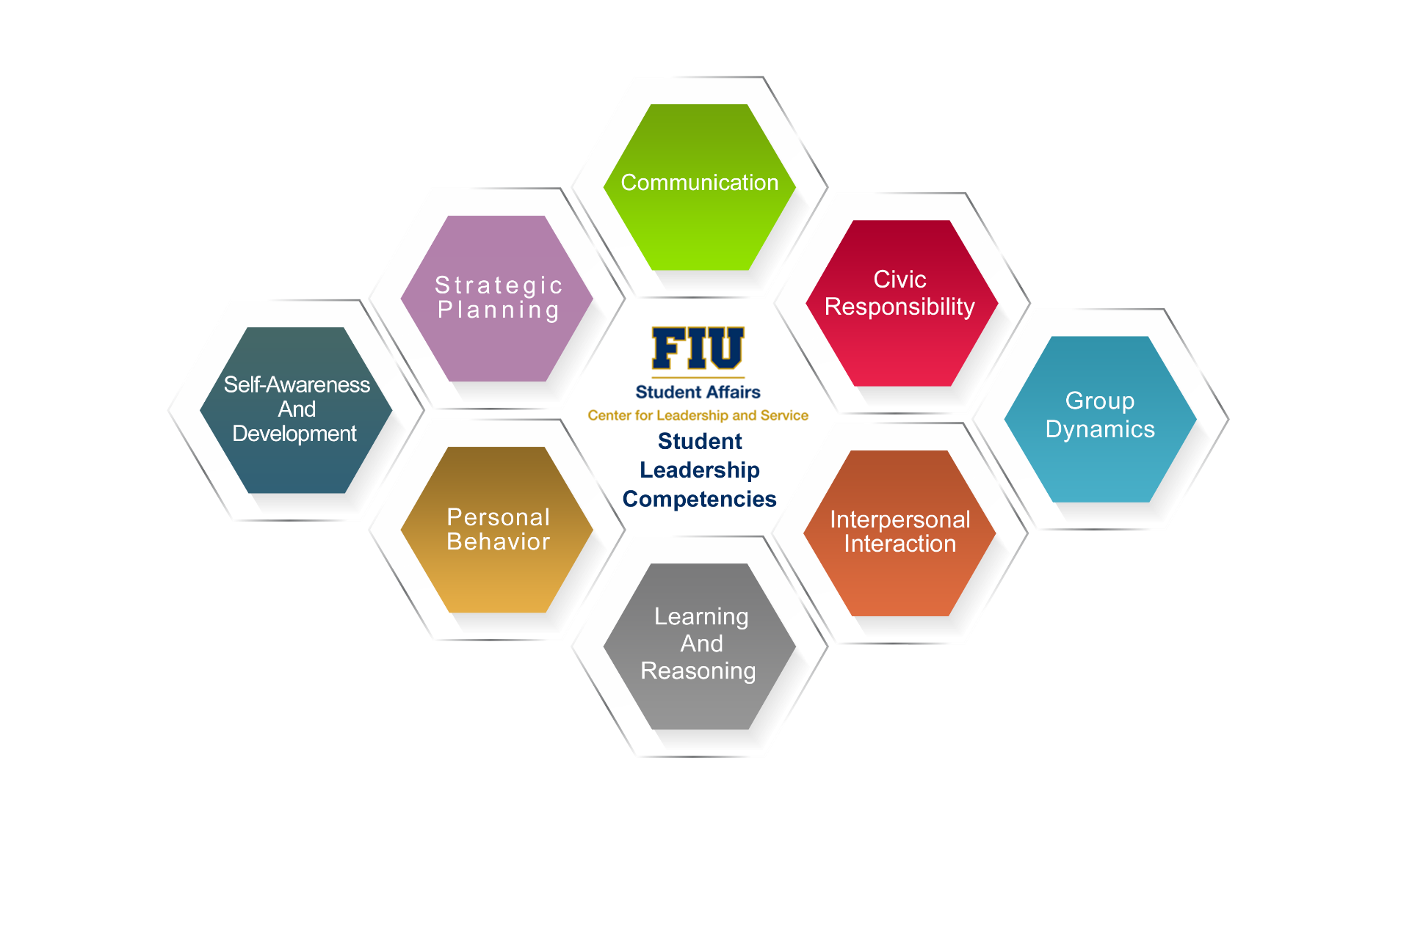
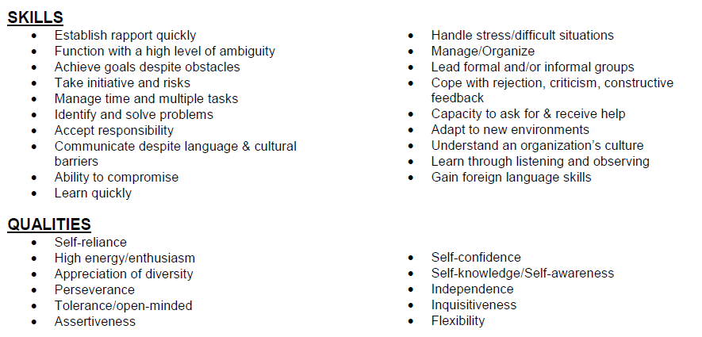
Potential Competencies & Skills (Multi-Source, Experience-Specific)

Slide 5
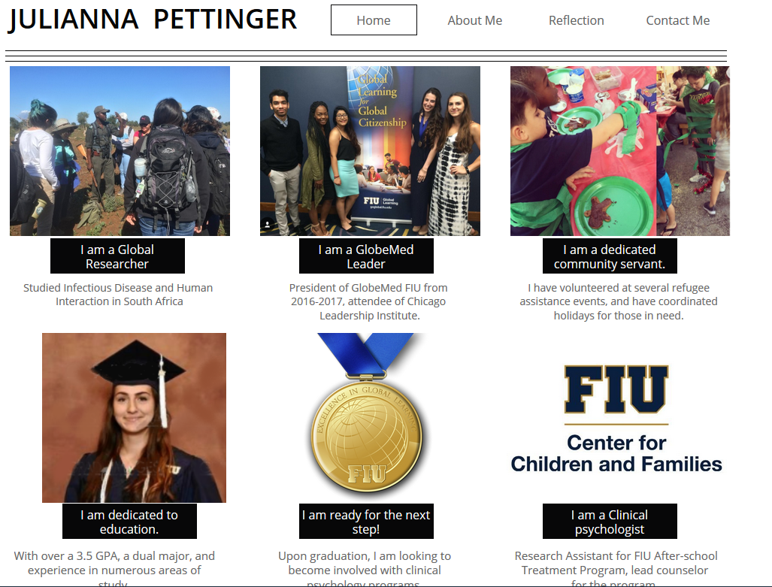

Slide 6
First exposure: curricular
Skills
Co-Curricular Extension
Takeaway
What’s Next

Slide 7
Data Collection and Archive

Slide 8
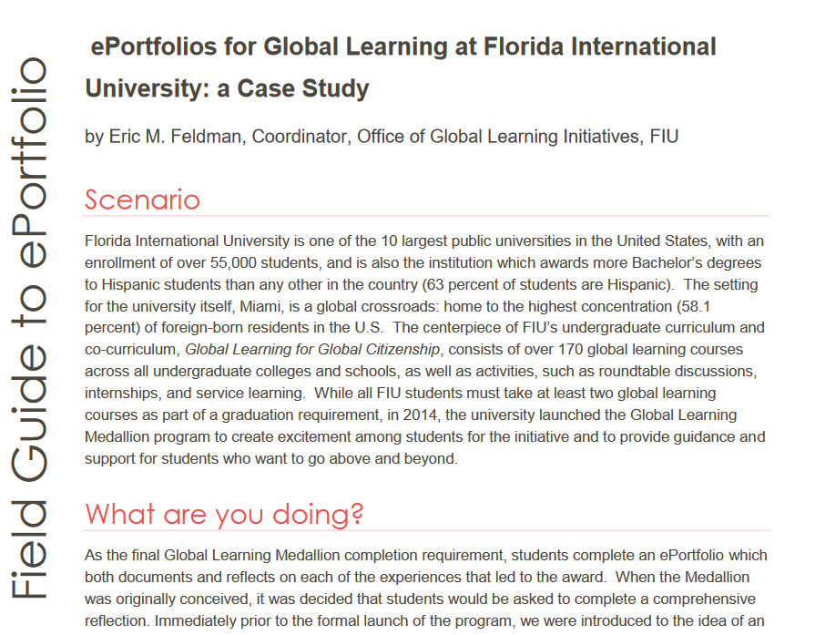
Eric M. Feldman, M.S., Program Manager
ericf@fiu.edu
http://goglobal.fiu.edu/medallion/eportfolio
http://go.fiu.edu/ePortFieldGuide

