Slide 1
Replicating Intercultural Learning in the High-Tech Classroom: Unforeseen Challenges
Bernardo Antonio González
Director, Fries Center for Global Studies & Professor of Spanish
Wesleyan University

Slide 2
Reflecting or constructing an intercultural reality?
”unprecedented levels of mobility & exchange”
“an increasingly interdependent world”

Slide 3
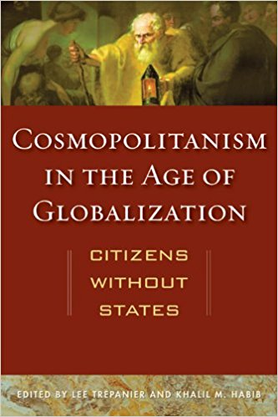
Readings in cosmopolitanism: wishful thinking?

Slide 4
Duration of time spent abroad: 2003 - 2014
On the decline: One semester / academic year
On the rise: 8 weeks or less during the academic year

Slide 5
The concentric circles of experience
How to make the connection between self and humanity?

Slide 6
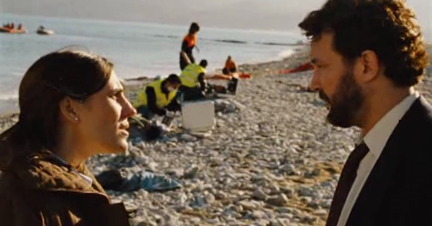
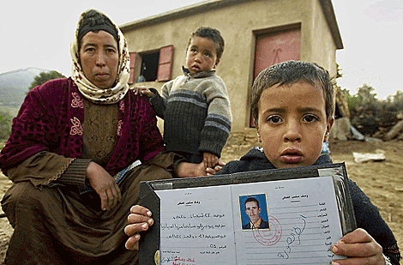
Chus Gutiérrez, Retorno a Hansala: “the journey that changed them forever”

Slide 7
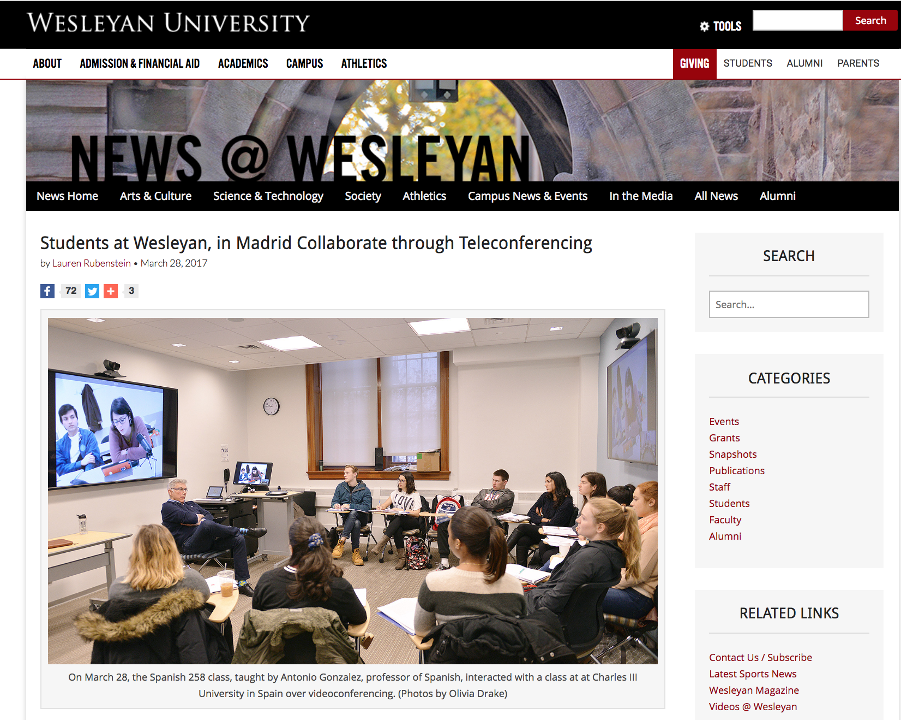
Technology & the intercultural classroom

Slide 8
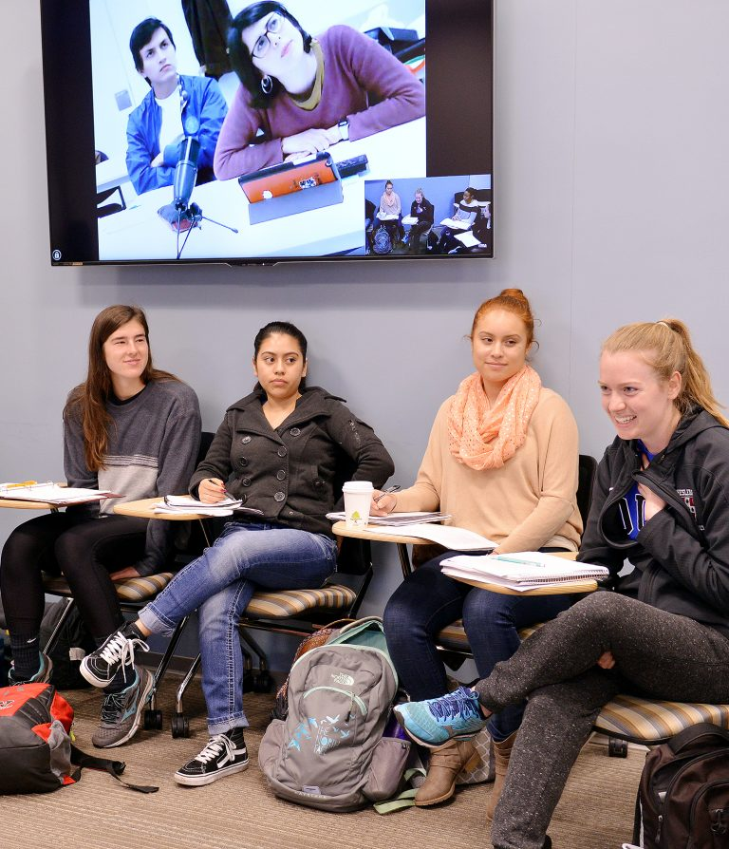
Technology & the intercultural classroom

Slide 9
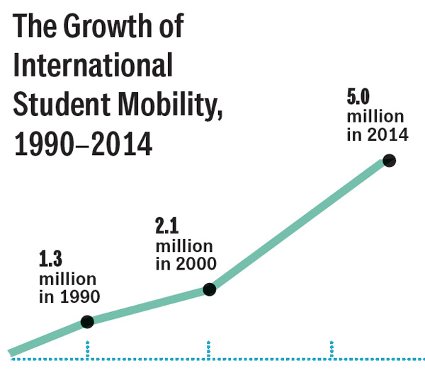
The ”enormous” increase in mobility → ???
US & European Student mobility 1985 - 2012
International student mobility 1990 - 2014

Slide 10
Wesleyan senior survey: 2015-2017
95% of those who have studied abroad
express overall satisfaction
with their
undergraduate experience

